Slide 1
Orange County Council
2023
Popcorn Sale
Please send a message with your name and unit(s) you are representing
Notes:
Title Slide Option 2

Slide 2
Best Partner for OCC
…. making life easier for you!

Slide 3
Why Popcorn?
Fund your unit’s program
Character development
Awesome Rewards
Improve our camps and council resources
More adventures, less time fundraising!
OVER $4 BILLION returned to your programs SINCE 1980

Slide 4
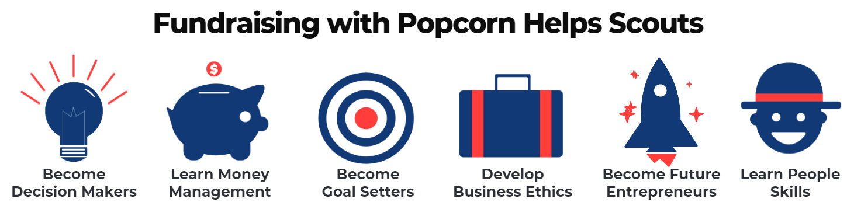
Why Popcorn?
Benefits for Scouts...
Personal growth program that can be applied to advancement opportunities and service projects.
Earn Amazon.com gift cards
Millions of prize choices
Youth buy prizes they want
Scouts Learn...
How to help others around them
Public speaking & math skills
Salesmanship & perseverance
How to earn their own way
The value of hard work
To be part of something bigger

Slide 5
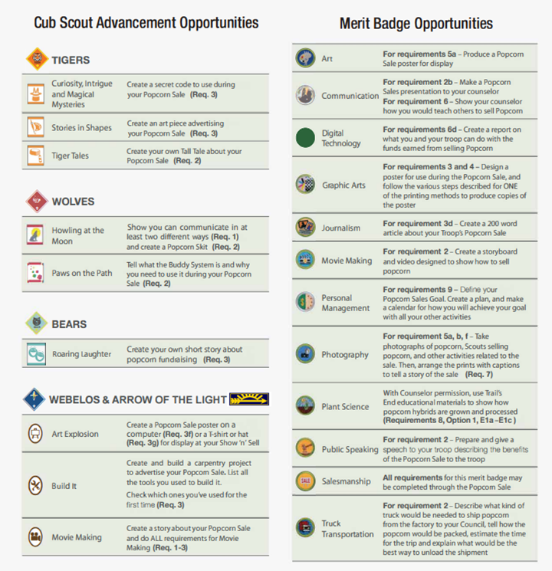
Why Popcorn?
Can help Cubs earn adventures
Can help Scouts earn merit badges
This graphic is available in the Leader Guide.

Slide 6
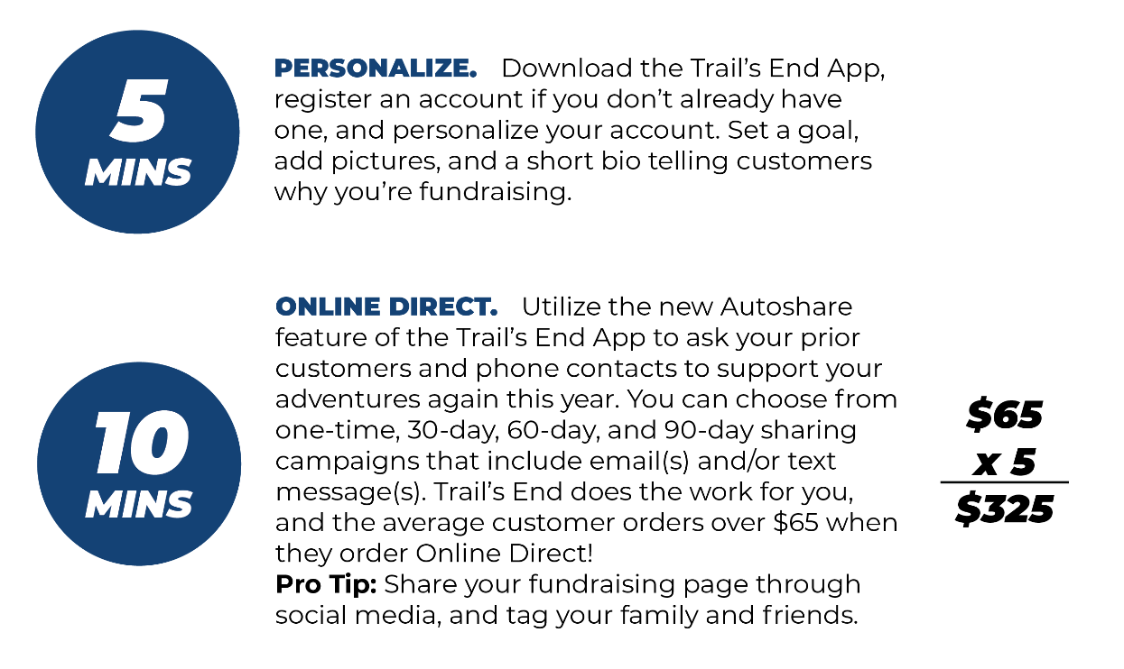
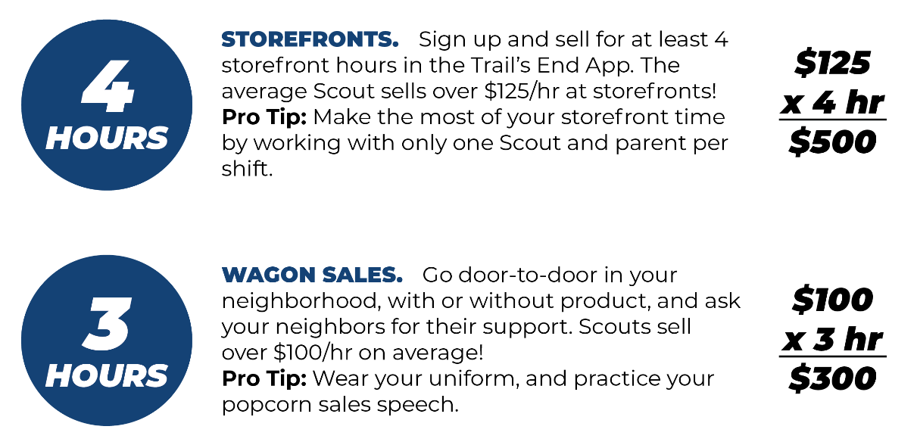
Text MYPLAN to 62771 to download: How to Sell $1,000 in under 8 hours

Slide 7
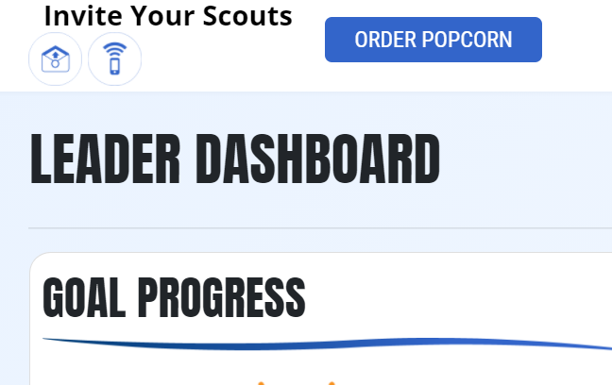
Steps to Success
Build Your Plan
2023-2024 Program Plan & Budget
Selling Methods (Storefront, Wagon, Online)
Unit Incentives (pie in the face)
Communication / Unit Kickoff
Invite Scouts to Register
To get App
Hold ‘High Energy’ Unit Kickoff
Present 2023-2024 Program Plan & Budget
Parent Buy-In
Scout Training
All Scouts Registered on Trail’s End App.
Use Kick-off PowerPoint on ‘Training’ tab on Leader Portal
LEADER PORTAL

Slide 8
OCC – Register your Unit!
Agenda
Products
Visit https://ocbsa.org/popcorn

Slide 9
Orange County Council
Agenda
Q: What’s New This Year?
A: Almost everything!!
Products

Slide 10
What is the same in OC?
We are selling Trail’s End popcorn
Using the Trail’s End technology
Website: www.ocbsa.org/popcorn
Please visit this page for all your resources/update
Staff Advisor – Randall Aldrich
Distribution location – OC Food Bank
Ducks Club with some improvements
Council Facebook Group
Agenda
Products

Slide 11
What is new in OC?
Theme!
We have a theme to our sale this year!
Hockey!
Agenda
Products

Slide 12
What is new in OC?
Sales Timeline
Added August distribution (optional)
Storefronts available through 12/3
Kickoff scheduled for 8/3
Potentially at Honda Center
Top Selling Unit Dinner
March/April 2024
Notes
There is a 4-month window of selling available
BSA policy limits scouts from selling products more than 12 total weeks in a 12-month period.
Ideally the scout is only selling during a 2-month period for popcorn. (1 month for Camp Cards)
Agenda
Products

Slide 13
Distribution Dates
Early Bird
Unit Orders Due Monday, 7/17
Distribution Day Saturday, 8/5
Order Full Cases
Receiving product you are selling direct to the customer.
Show and Sell
Unit Orders Due Friday, 8/28
Distribution Day Saturday, 9/16
Order Full Cases
Receiving product you are selling direct to the customer.
Replenishment
Unit Orders Due Monday, 10/9
Distribution Day Saturday, 10/21
Order Full Cases
Replenish stock of popcorn to sell direct to customer.
Final Order*
Unit Orders Due Monday, 10/30*
Distribution Day Saturday, 11/18
Order individual items
Order items sold to the customer that the unit didn’t have already.
Agenda
Visit Council Website
ocbsa.org/popcorn
Products

Slide 14
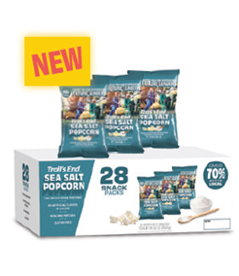
Trail’s End Products
$25
12-pk Unbelievable
Butter
$15
Popping Corn
Agenda
$15
Kettle Corn
$25
Salted Caramel
$20
White Cheddar
$25
S’mores Popcorn
Products
$50
28 pack Sea Salt Popcorn

Slide 15
What else is new?
Return Policy Change!!
There is no limit on unit returns…. but,
The less you return, the better your commission rate.
There will be help given to allow everyone the chance to maximize their commission %.
Weekly sell through analysis given to the units to keep them on track.
Proper utilization of the Facebook group to transfer product to a unit in need.
Agenda
Products

Slide 16
What is my commission?
Base | Standard Commission for every unit that sells popcorn. | 30%
Scouts Honor Bonus | Adhere to the Code of Conduct, follow all deadlines, attend kickoff, make all payments and turn in all forms on-time and sell more than 80% of the total product checked out from council and/or transferred from other units during the sale. | 2%
10K Bonus | Sell a minimum of $10,000 and sell more than 90% of total product checked out from council and/or transferred from other units during the sale. | 2%
$1 More Bonus | Increase your sales over 2022 by $1. | 2%
TOTAL |  | 36%
Online Sales | Separate from regular sales commission. | 35%
Agenda
Products

Slide 17
How can a scout sell?
In Person
Storefront
Can share sales at a store with another scout
Unit can set the sharing to be on the same shift, same day, or across all storefronts.
Wagon Sale
Individual scout selling to a customer.
Can use this method even if the scout does not have the product (use to be take order paper form)
Online Direct
The scout can order online items for the customer.
The product is shipped directly to the customer from Trail’s End.
Do not use this method to sell product that the unit ordered.
Online
Each scout has a unique sellers page.
If the scout goes through the Trail’s End App, they can customize their page.
There is an option to share their page with contacts on the phone.
Post a link to the seller’s page on social media sites.
Agenda
Products

Slide 18
OC & Trail’s End Storefronts!
SAVE TIME AND
PREVENT DOUBLE BOOKINGS
Trail’s End and the Orange County Council have been contacting local stores and securing hours again for this Fall.

Slide 19
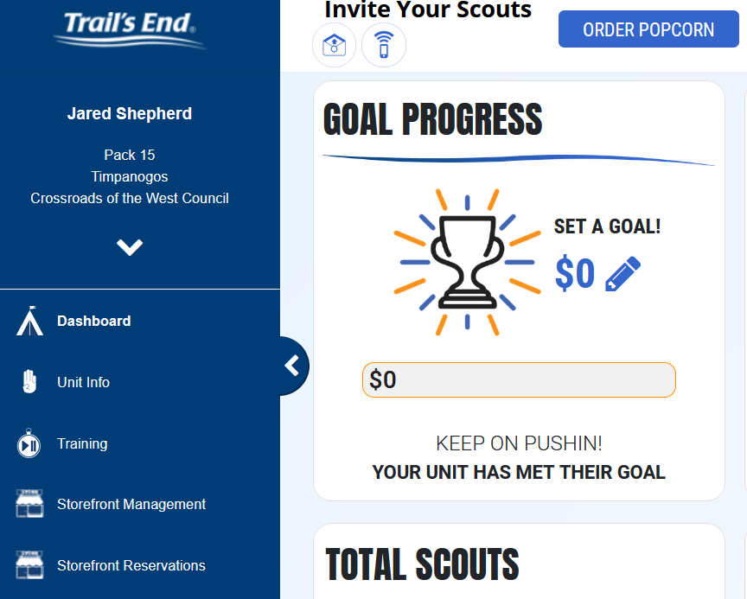
Storefronts Cont.

Slide 20
Storefronts Cont.

Slide 21
Storefronts Cont.
Storefront hours secured as of 5/3/23:

Slide 22
Storefronts Cont.
Storefront Claiming Dates
Picks go live at 9:00AM on the dates listed below
Saturday, June 24th - $20K & above Units, 3 Picks within District
Sunday, June 25th - $20K & above Units, 3 Picks within District
Monday, June 26th - $10K & above Units, 2 Picks within District
Tuesday, June 27th - $10K & above Units, 2 Picks within District
Wednesday, June 28th - All units, 2 Picks within District
Thursday, June 29th - All units, 2 Picks within Council
Friday, June 30th - All units, Unlimited Picks within Council

Slide 23
Trail’s End App Sales
SAVE TIME MANAGING YOUR SALE!
An easy to use ‘Point of Sale’ app (Google Play & Apple stores) for Scouts to track and report real-time sales. It accepts cash and credit cards, tracks inventory by Scout, and allows Scouts to manage storefront shifts.
FREE CREDIT CARD PROCESSING
Powered by Square | Paid by Trail’s End
Every Scout, every sale will receive free payment processing!
Square is the leading credit card solution for units.
Compatible with all Square Readers (not required to take credit cards).

Slide 24
Trail’s End App
SIMPLER AND SMOOTHER INTERFACE (new & improved in 2020 & 2021!)
3 selling modes: Wagon, Storefront, Online Direct.
‘Text order/cart’ feature for socially distant payments.
Scout families can turn in cash payments via credit card for less cash handling.
Easily handles multiple Scouts within a family.
Scouts see real-time ‘rankings’ (Unit, Council, Nationally).
2022 App Sales Metrics
90+% sales logged through the app.
50+% of total sales via credit card.
Average credit sale 27% greater than cash.

Slide 25
Trail’s End App
The next slide will show an example of a Wagon Sale.
A storefront sale will be the same process but under storefront mode.
This mode is used to share commissions across multiple scouts at a storefront.
Same process for an online sale under online direct.
For online direct, you will have to enter the customers information to have Trail’s End mail the product directly to them
If you are doing a take order (selling product and then putting in the order at the end to deliver around Thanksgiving), the process is the same, but you will not mark the item as delivered.

Slide 26
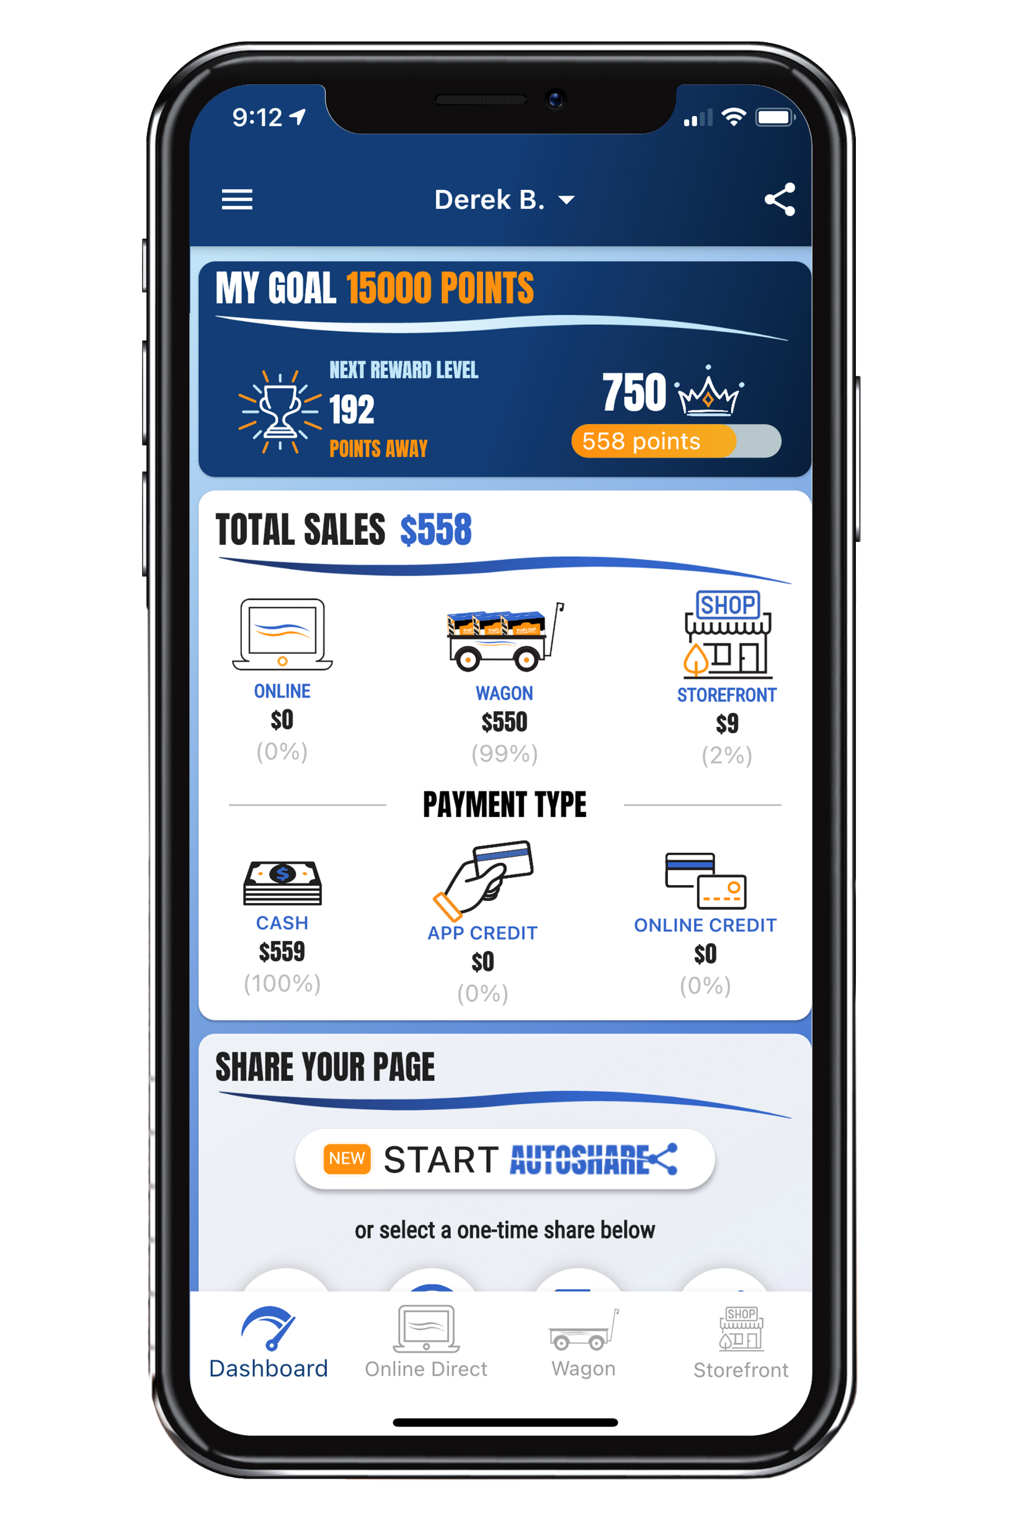
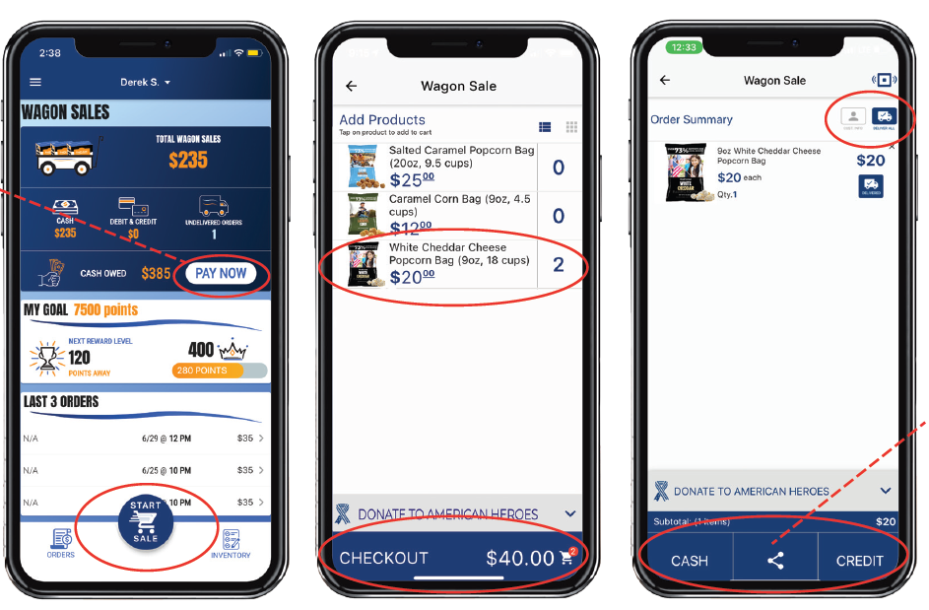
Trail’s End App

Slide 27
Online Sales
FREE SHIPPING on orders over $70.
For Orders under $70, a $13.99 flat handling fee applies
For Orders with MW or Popping Corn, $3 charge per item.
Scouts and leaders don’t handle products or cash.
Average order is $63 vs $28 traditional.
As many traditional products and prices as possible.
*NEW Online Direct feature where Scouts can take an online order in the app that ships directly to the customer. No return trip needed.
*NEW AutoShare feature enabling Scouts to manage their online sales campaign.

Slide 28
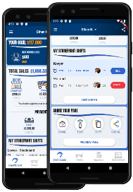
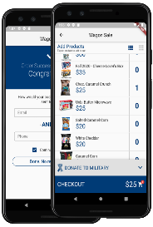
NEW Online Direct
HOW IT WORKS
TWO WAYS TO SELL
SHARE YOUR PAGE
Share your fundraising page via email, text, or social media.
Customers click your link to place online orders.
Products ship to your customers.
TAKE ONLINE DIRECT ORDERS IN THE APP
Pick your products.
Take payment (credit/debit only)
Products ship to your customers.

Slide 29
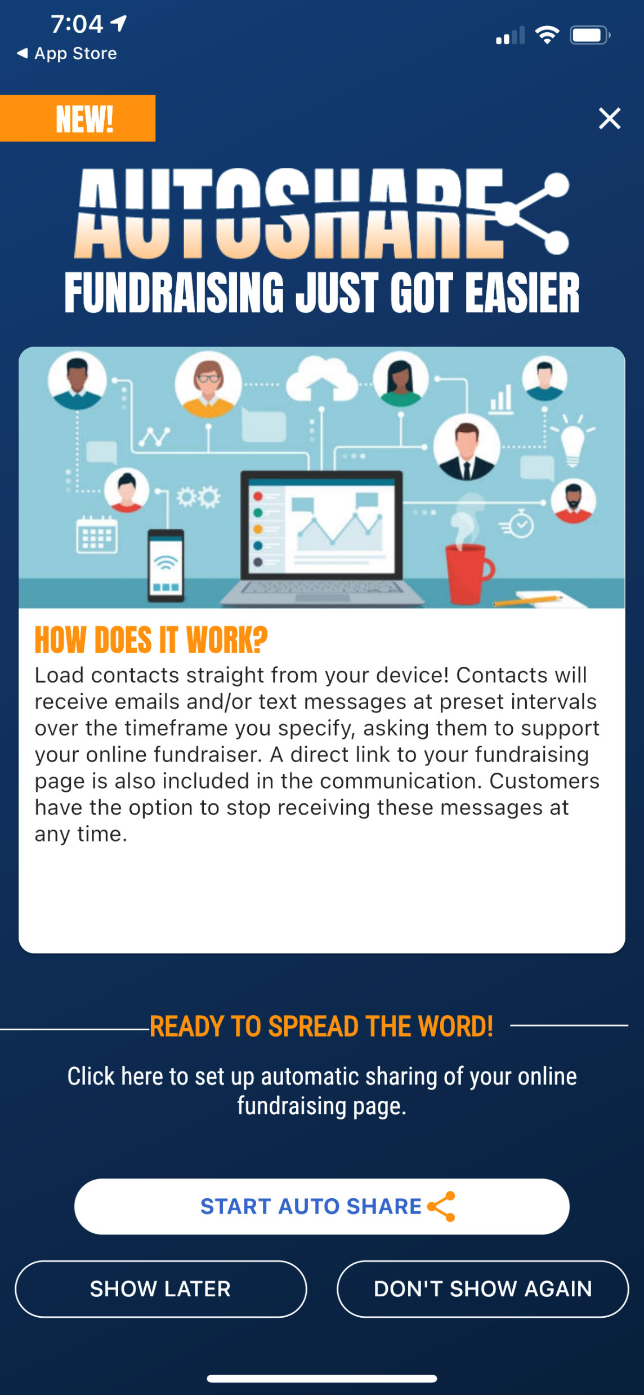
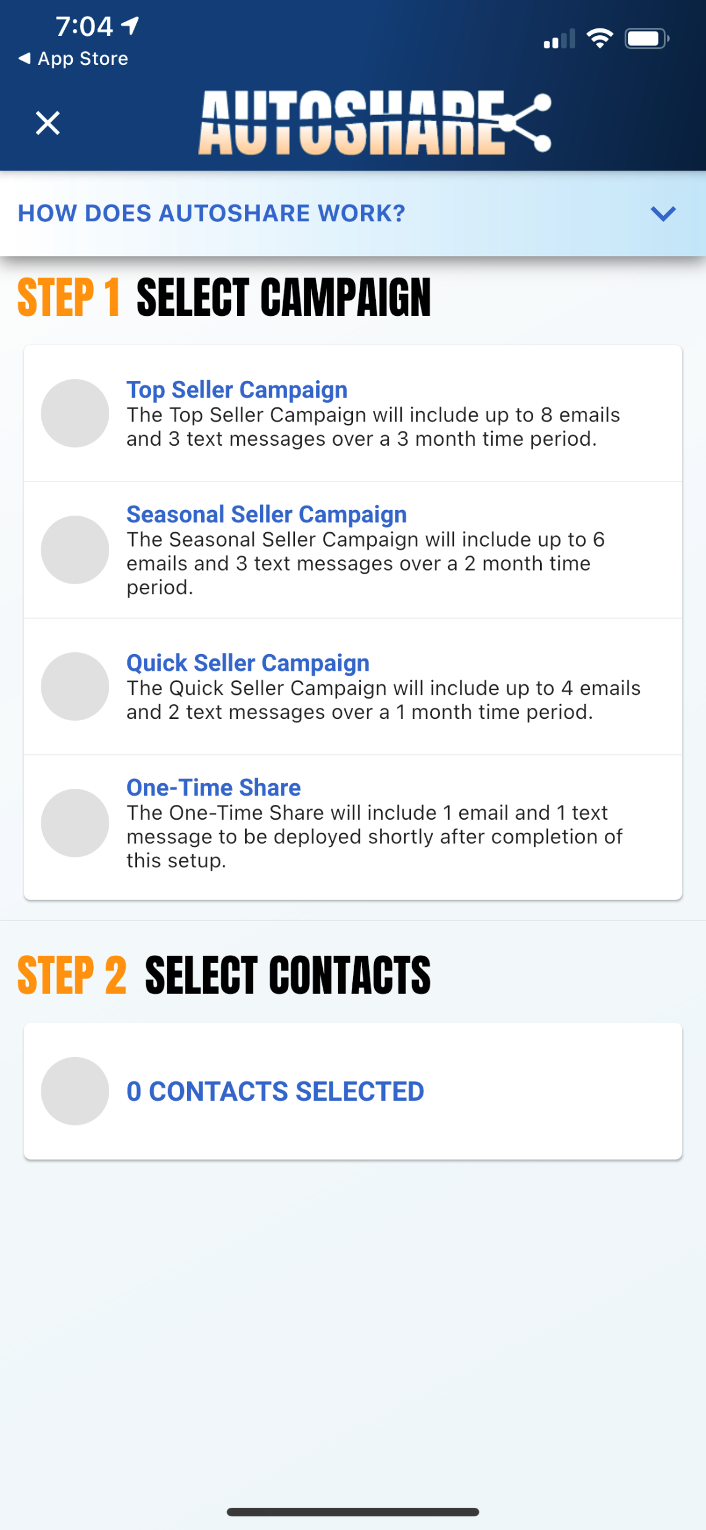
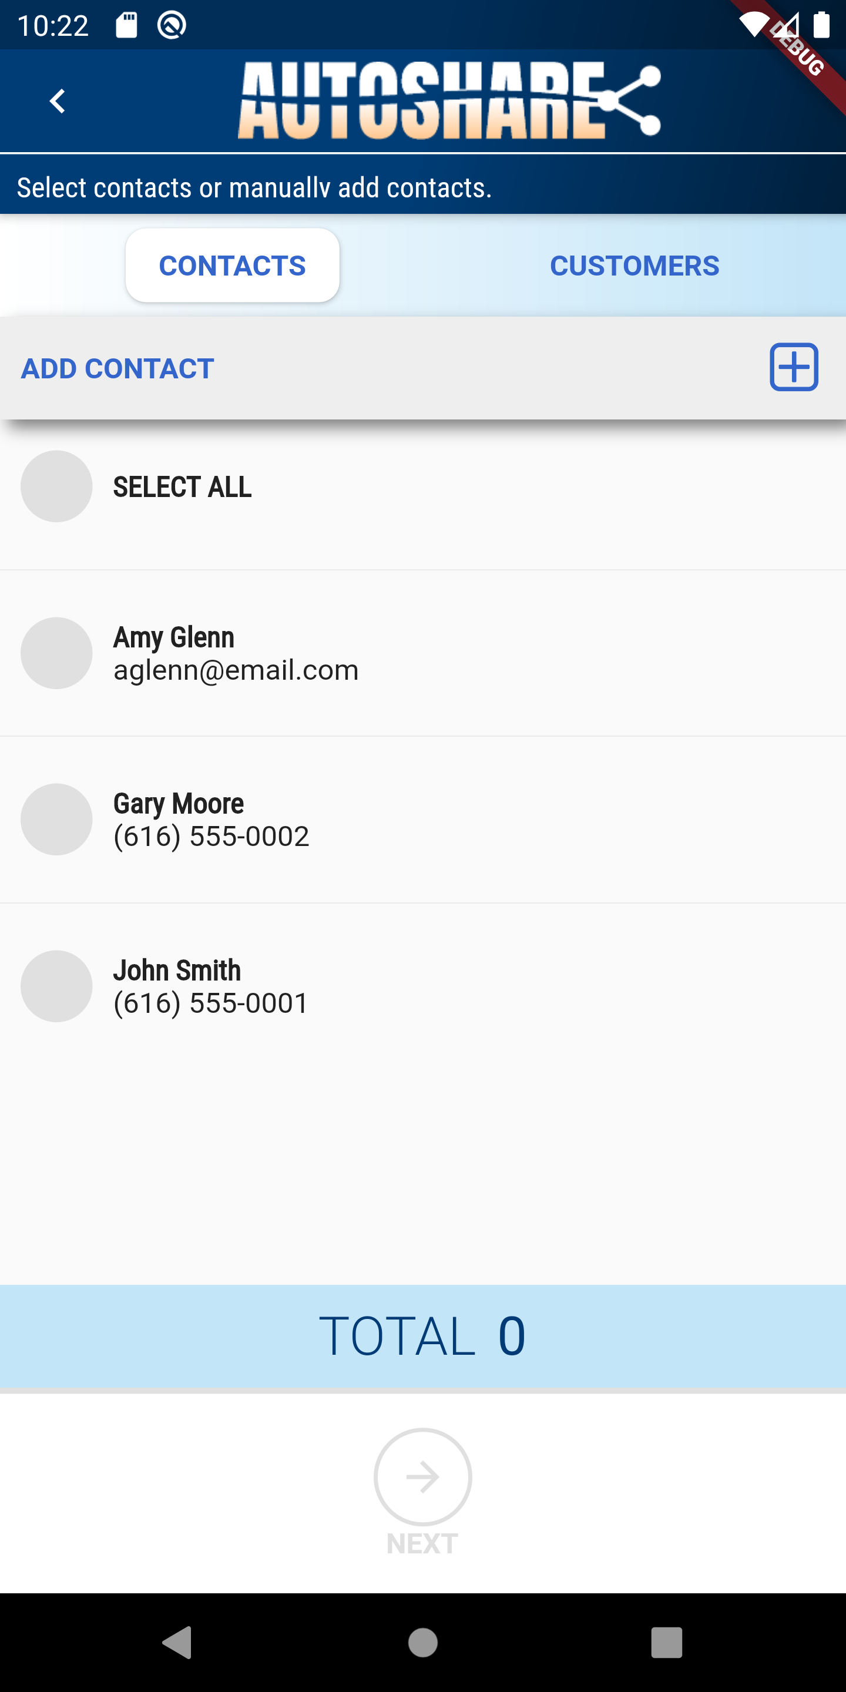
Online Direct
AUTOSHARE
Agenda
Your Online Direct Campaign just got a whole lot EASIER! It's as easy as 1-2-3!
Click Start AUTOSHARE
Choose the sharing Campaign that fits your goals.
Select your contacts straight from your device.
Products

Slide 30
Seller Rewards
We have added more rewards to the sale this year!
Trail’s End has 25% boosted points for online, credit and debit transactions vs cash/checks.
Lots of council sponsored prizes this year!!
2 patches available!
Ducks merchandise!
Ducks game!
All rewards are based on in-app sales. If there is a scout not selling with an app, a leader can add the sale manually through the leader portal.

Slide 31
Trail’s End Rewards
Save time and Sell more!
Scouts redeem Amazon.com gift cards in app.
Saving time for unit leaders. No approving, receiving, distributing, or replacing prizes.
Surveyed unit leaders: TE Rewards reported saving an average of 6+ hours.
Prizes are better! More value and more choices.
Amazon offers 500 million items! (vs 5-6 per level with other prize vendors)

Slide 32
Trail’s End Rewards
These are 2022 reward tiers. May have minor changes in the next couple of weeks. (5/13)

Slide 33
Council Rewards

Slide 34
Council Rewards
$ of Popcorn Sold | Reward
$1000 | Become a member of the 2023 Duck’s Popcorn Club • Limited Edition Duck’s Popcorn Club T-shirt with all members listed on the back (First name, Last initial)
$3000 | Ducks Hat of scouts choice from the Team store
$5500 | Standard Ducks home jersey
$8000 | Customize your jersey with a name and number.

Slide 35
Duck’s Rewards
$1000+ sellers
2 Tickets to a Popcorn Celebration Game
On ice experience -1 hour broomball session at the Honda Center before or after the game for the 30th anniversary celebration
30th Anniversary themed Scout Night patch
Top 10 Sellers
Top seller receives a signed Ducks jersey and a Zamboni ride during the Popcorn Celebration game
2nd place receives a player-signed limited edition wooden stick
3rd place, 4th place, 5th place receive signed pucks
6th – 10th place receive a signed photo
Top Unit
Color Guard for the Ducks Celebration Game
They will be on-ice during the opening ceremonies for the game
There are 4 spots for scouts to be on the Color Guard
The Top Unit is the unit with the most scouts that sold over $1000

Slide 36
Leader Resources!
Trail’s End Webinars
https://www.trails-end.com/webinars
Facebook
Trail’s End Community Facebook
Find out information across the nation and direct from Trail’s End
Orange County Council Facebook
Connect with other units to transfer popcorn
Trail’s End Leader Portal
Resources tab has videos and special downloads
www.ocbsa.org/popcorn
Agenda
Products

Slide 37
Facebook Communities
Trail’s End Facebook Communities:
Over 30,000 Unit leaders and Scout parents are members.
During the sale, over 1,300 comments and over 3,600 reactions made each day.
BSA Adult Leaders moderating and providing content, in addition to Trail’s End customer service staff. Unit leaders and Scout parents get real-time best practices and answers from peers and TE experts 24/7.
Text FACEBOOK to 62771 to join our community today!
Join Scout leaders across the country to share best practices and new ideas!

Slide 38
Trail’s End Leader Portal
Manage your unit’s entire sale in one place!
Order Popcorn
Invite your Scouts to register; manage Scout roster
Submit Scout Rewards
Set your unit and Scout goals
View real-time reporting of sales, inventory and cash management; all in one place
UNIT to UNIT product transfers
Create, schedule, and manage storefront sites and shifts
Training Resources

Slide 39
Trail’s End Leader Portal
Ordering Popcorn
Under the “Popcorn” tab
Will ask how much you are looking to sell
It will pre-fill recommended qty based on sales data
You may change the product mix if you know what you would like to order.
Account Summary
This will show your balance, payout available, and pending credits
You will owe council the value of the popcorn ordered (minus any commission, credit card payments, and returns) at the end of the sale.
We will start collecting in November and all will need to be paid by December roundtable (12/14).
Avoid paying council anything!!
If you have 70%+ credit card sales then you do not owe council anything.
You will be eligible for Trail’s End to pay your unit
Customers naturally pay by card 80% if the time.
If there are cash wagon sales rung through the app, parents can pay what cash they collected with a card and not turn in the money to the unit!
This reduces the need to reach out to multiple parents for money, and reduces the need to pay council.

Slide 40
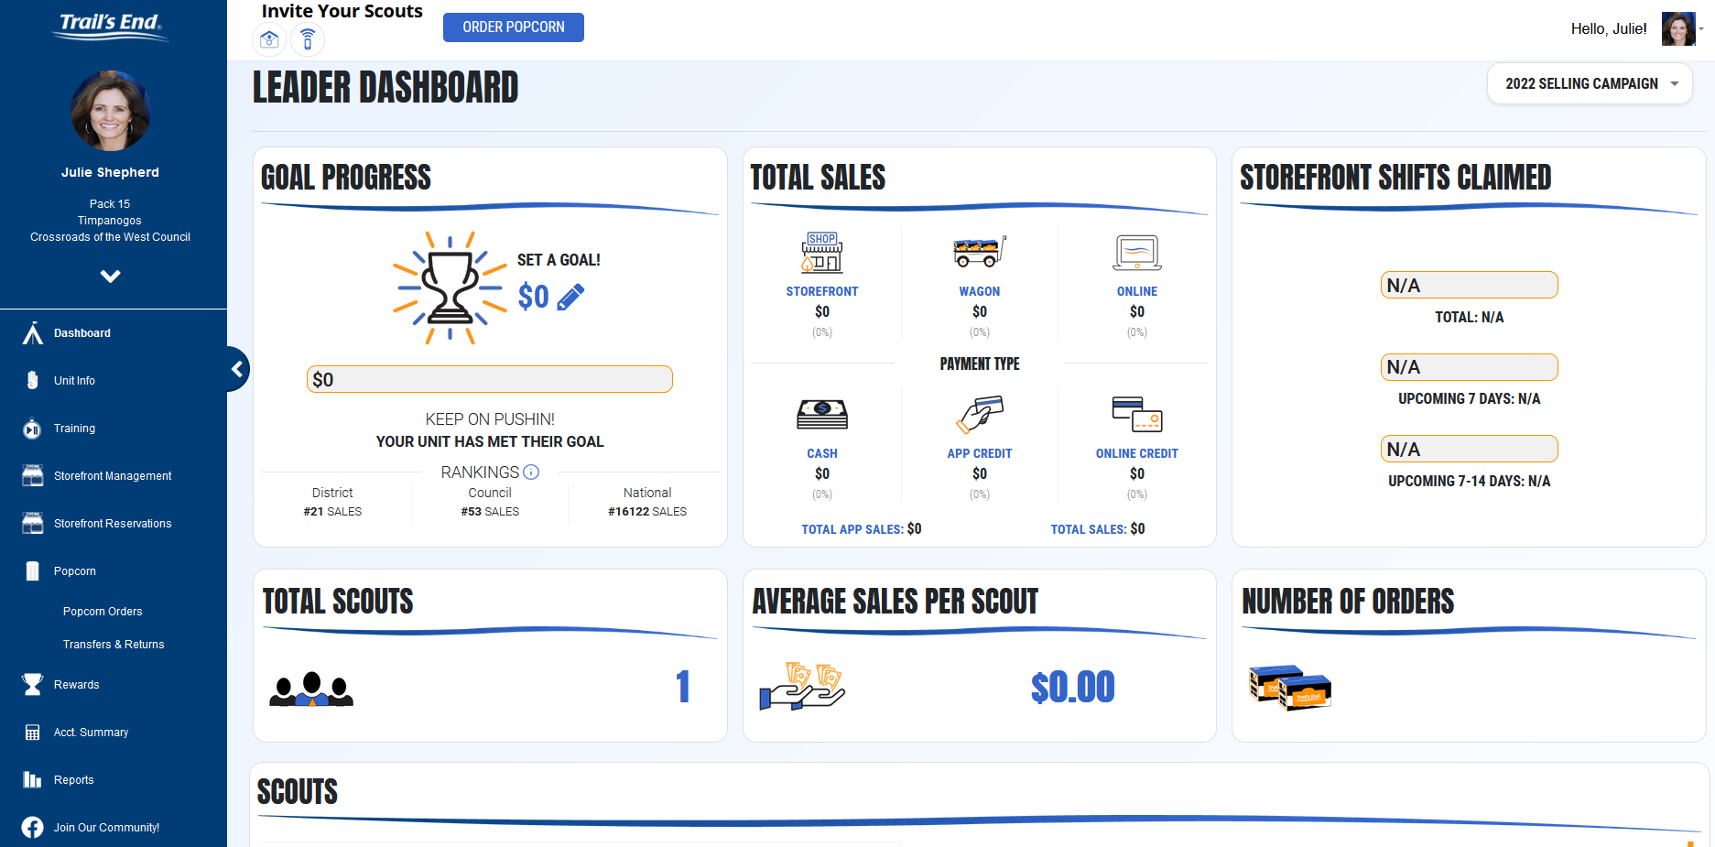
Trail’s End Leader Portal
Manage your unit’s entire sale in one place!

Slide 41
Watch Webinar on TE Leader Portal
Agenda
Products

Slide 42
Questions?
Comments?
Thank you!!
Notes:
End Slide Option 2

