Slide 1
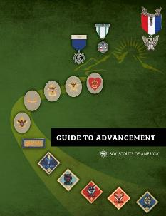
Orange County Council
Merit Badge Day Coordinator Training
Written and approved by the Orange County Council Advancement Committee. Reviewed 11/1/2022.
Notes:
[Presenter Notes: Begin with a simple opening ceremony such as the Pledge of Allegiance and perhaps the reciting of the Scout Oath and Scout Law. Then welcome everyone and thank them for attending. They could be doing something else with their time, but they chose to be at this presentation.
Challenge participants to ask questions and encourage them to join in the discussions.]
Background note to the presenter with supplies needed:
This merit badge counselor orientation presentation provides new and prospective merit badge counselors with the basic knowledge and skills needed to get started, and can serve as a refresher to veterans. It involves a step-by-step overview of the registration and approval process, speaks to the requirement for Youth Protection training, and discusses helpful methods and resources. Participants will learn about their unique role, the process of counseling, and the related BSA national policies and procedures. The orientation takes approximately 60 to 90 minutes depending on the experience level of those attending.
Like all the orientation and educational experiences produced by the National Advancement Committee and its Webinars and Education Task Force, this session has an expiration date, after which it is not to be used. Upon that date a replacement session will be available at the URL shown on the first slide. This will provide unit, district, and council volunteers with the latest information.
We encourage presenters to have at least one copy of the following publications for use during the presentation:
The Guide to Advancement, No. 33088
Any issue of Advancement News
Boy Scout Requirements, No. 33216
A few merit badge pamphlets (at least one that is Eagle-required)
Application for Merit Badge (blue card), No. 34124
Merit Badge Counselor Information form, No. 34405
BSA Adult Application, No. 524-501
We also encourage presenters to have copies of their latest council newsletter and a handout with key council contact information, and any instructions about special certifications or training that the council advancement committee requires in order to approve counselors for specific merit badges.
A flip chart or white-board, and pens may come in handy.
If your session will include volunteers unfamiliar with Scouting, it may be helpful to prepare signs or flip chart sheets showing the Scout Oath and Scout Law.
The National Advancement Team welcomes any and all feedback through advancement.team@scouting.org, but would ask that questions and concerns first be shared with local district and council volunteer or professional advancement administrators.
The National Advancement Committee's Webinar and Education Task Force’s dedicated Scouting volunteers who helped develop this presentation wish you great success in giving merit badge counselors the tools they need to better serve today's young people.

Slide 2
What’s the History Behind this Training?
Started around 2015
Merit Badge Days run amuck!
Units holding 3, 4 sometimes 5 MB Days/year!
Guide to Advancement – 2021
Specific rules about group MB Days
Notes:
[Presenter Notes: Ask participants to review this slide and then invite them to bring up any specific details or issues they would like to be sure are addressed. List these on a flip chart or white-board. At the end of the session you can go back and pick up any topics that were not covered.]

Slide 3
What’s the History Behind this Training?
Council providing guidance:
Quality.
Standardization.
Merit Badge Days are Advancement Activities not fund raisers.
Align Merit Badge Day Policy with Group Merit Badge Instruction practices in the Guide to Advancement.
Notes:
[Presenter Notes: Ask participants to review this slide and then invite them to bring up any specific details or issues they would like to be sure are addressed. List these on a flip chart or white-board. At the end of the session you can go back and pick up any topics that were not covered.]

Slide 4
In the end, the Scout must be reviewed individually by the Counselor to ensure completion of the Badge’s requirements.
Notes:
The “mechanics” of advancement are covered in section 4 of the Guide to Advancement. An understanding of the four steps in Boy Scout advancement is critical to the process. It is in going through the steps that we meet the aims of Scouting, and each step is equally important as any other. Merit badge counselors are directly involved in the first two; the others come later.
It is vital to remember that the advancement method, including the earning of merit badges, is just a method. Advancement and merit badges are not ends in and of themselves.

Slide 5
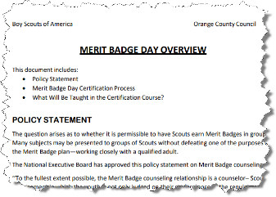
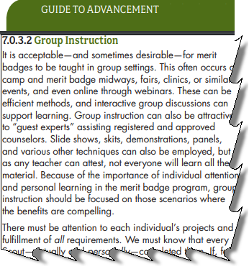
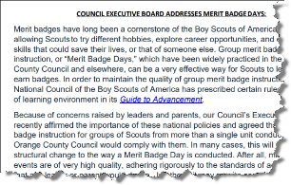
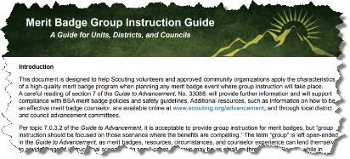
Expectation
Synchronization between many policies/processes:
OCBSA Policy & Board statement
Guide to Advancement
National Merit Badge Group Instruction Guide
Notes:
[Presenter Notes: Ask participants to review this slide and then invite them to bring up any specific details or issues they would like to be sure are addressed. List these on a flip chart or white-board. At the end of the session you can go back and pick up any topics that were not covered.]

Slide 6
Bottom Line
Each Merit Badge Day host will have at least two registered, youth protection and AB506 trained adults that are certified through Council training as Merit Badge Day Coordinators.
Standardized rules ensuring quality and consistency across all Orange County Council Merit Badge Days
Notes:
[Presenter Notes: Ask participants to review this slide and then invite them to bring up any specific details or issues they would like to be sure are addressed. List these on a flip chart or white-board. At the end of the session you can go back and pick up any topics that were not covered.]

Slide 7
Merit Badge Program
An integral part of the advancement program.
Advancement is only one of the Aims of Scouting.
Ideals
Patrols
Outdoor Program
Advancement
The Merit Badge Program encourages Scouts to speak with their Unit Leader to obtain MB Counselor information, and discuss working on that Merit Badge with their Unit Leader.
Association with Adults
Personal Growth
Leadership Development
Uniform
Guide to Advancement 7.0.2.3
Notes:
Before working with Scouts, counselors must complete Youth Protection training. The online course is available by logging into myscouting.org. Counselors, who live in states that require face-to-face, instructor-led training, are encouraged to contact their local councils for training dates and times.
When completing the course, volunteers should attach a copy of their certificate to their adult registration application and information sheet, and follow council guidelines for submitting these documents.
7

Slide 8
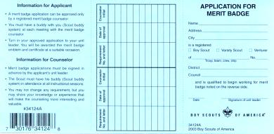
The Merit Badge Process
Scout indicates interest; discusses with Unit leader; gets MBC name and blue card
Unit reports advancement and obtains badge for presentation
Scout contacts Counselor
Scout returns completed Merit Badge card to Unit leader
Scout/Counselor first meeting
Counselor approves completion
Subsequent Scout/counselor meeting
Subsequent Scout/counselor meeting
Subsequent Scout/Counselor meetings
Scout completes requirements
Notes:
In review, here’s a chart that outlines the process the BSA considers the best approach to getting the most out of the merit badge program.
[Note to presenter: Give participants a chance to review the chart and invite them to ask questions.]

Slide 9
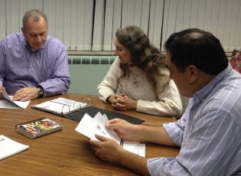
Merit Badge Counselor Qualifications
At least 18 years of age.
Registered with Orange County Council as a BSA Merit Badge Counselor.
Recognized as having skill or knowledge in the subject for which they are serving as a Counselor.
Approved by the Council Advancement Committee, which has been delegated to the District Advancement Committees for the Badge being counseled.
Guide to Advancement 7.0.1.1
Notes:
In order to qualify as a merit badge counselor, prospective volunteers must have the education and skills needed to provide instruction and to evaluate performance. It is also important they are older than the Scouts and are able to set that positive example. This calls for both good rapport and good character.
These are the only qualifications the BSA National Council places on merit badge counselors—regardless of the merit badge. Local councils, however, when approving counselors, may look for more, but they are not allowed to accept less.
9

Slide 10
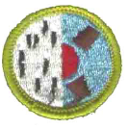
Merit Badge Counselor Qualifications (Continued)
All Counselors are required to complete Merit Badge Counselor Training.
Online at My.scouting.org
OR
Scheduled Merit Badge Counselor Training sessions (such as University of Scouting)
Notes:
In order to qualify as a merit badge counselor, prospective volunteers must have the education and skills needed to provide instruction and to evaluate performance. It is also important they are older than the Scouts and are able to set that positive example. This calls for both good rapport and good character.
These are the only qualifications the BSA National Council places on merit badge counselors—regardless of the merit badge. Local councils, however, when approving counselors, may look for more, but they are not allowed to accept less.
10

Slide 11
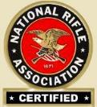
Merit Badge Counselor Qualifications (Continued)
Additional Merit Badge Counselor qualifications for specialty Merit Badges.
Guide to Advancement 7.0.1.1
Notes:
The BSA considers some merit badge activities riskier than others. A list of these badges is provided in the Guide to Advancement, topic seventy-eleven, “Qualifications of Counselors;” along with the specific qualifications required of those supervising the activities. For example, most of the requirements for the shooting sports merit badges require BSA National Camp School or National Rifle Association certification; and scuba diving activities must be presented by a trained instructor sanctioned by an agency such as PADI, the Professional Association of Diving Instructors. Of course, for the aquatics badges, all Swimming and watercraft activities must be offered in accordance with BSA Safe Swim Defense and BSA Safety Afloat, respectively.
If the merit badge counselor does not meet the specific qualifications listed, then he or she may use the services of others who do meet them. This is supported in topic seventy-thirty-two of the Guide to Advancement, where it says, “It is permissible for guest speakers, guest experts, or others who are not merit badge counselors to assist in the counseling process.”
As a side note, it must be remembered that any activities that take place within the merit badge program must be conducted in accordance with the Guide to Safe Scouting.
[If you are asked, the Guide to Safe Scouting is available at www.scouting.org/scoutsource/healthandsafety/GSS.aspx.]

Slide 12
Specialty Merit Badges
Archery,
Canoeing,
Climbing,
Kayaking,
Lifesaving,
Motor Boating,
Rifle Shooting,
Rowing,
NOTE: None of the specialty Merit Badges are recommended for Merit Badge Days.
Scuba Diving,
Shotgun Shooting,
Small Boat Sailing,
Snow Sports,
Swimming,
Water Sports,
Whitewater
Guide to Advancement 7.0.1.1
Notes:
The BSA considers some merit badge activities riskier than others. A list of these badges is provided in the Guide to Advancement, topic seventy-eleven, “Qualifications of Counselors;” along with the specific qualifications required of those supervising the activities. For example, most of the requirements for the shooting sports merit badges require BSA National Camp School or National Rifle Association certification; and scuba diving activities must be presented by a trained instructor sanctioned by an agency such as PADI, the Professional Association of Diving Instructors. Of course, for the aquatics badges, all Swimming and watercraft activities must be offered in accordance with BSA Safe Swim Defense and BSA Safety Afloat, respectively.
If the merit badge counselor does not meet the specific qualifications listed, then he or she may use the services of others who do meet them. This is supported in topic seventy-thirty-two of the Guide to Advancement, where it says, “It is permissible for guest speakers, guest experts, or others who are not merit badge counselors to assist in the counseling process.”
As a side note, it must be remembered that any activities that take place within the merit badge program must be conducted in accordance with the Guide to Safe Scouting.
[If you are asked, the Guide to Safe Scouting is available at www.scouting.org/scoutsource/healthandsafety/GSS.aspx.]

Slide 13
Merit Badge Counselor Lists
Each District maintains their own Merit Badge Counselor lists.
MB Counselor lists are available only to Unit Leaders, Committee Chairs and Advancement Chairs.
The confidentiality of Merit Badge Counselor personal contact information is important
Counselor lists are not given to Scouts or their parents/guardians.
Guide to Advancement 7.0.2.0
Notes:
Before working with Scouts, counselors must complete Youth Protection training. The online course is available by logging into myscouting.org. Counselors, who live in states that require face-to-face, instructor-led training, are encouraged to contact their local councils for training dates and times.
When completing the course, volunteers should attach a copy of their certificate to their adult registration application and information sheet, and follow council guidelines for submitting these documents.
13

Slide 14
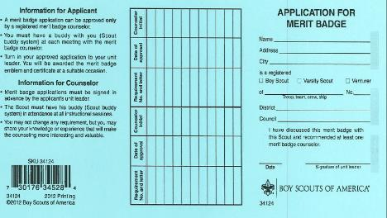
Application for Merit Badge
The Blue Card
The Unit leader signature:
Required for Scouts to work with Counselors.
Does not indicate Unit leader “approval”.
Evidence of discussion between Unit leader and Scout.
Indicates registered Counselor has been recommended.
Not required for Scout to get started on requirements.
“I have discussed this Merit Badge with this Scout and recommended at least one Merit Badge Counselor.”
Guide to Advancement 7.0.0.2
Notes:
The unit leader’s signature is required on the application before the Scout begins working with the merit badge counselor. This does not mean the young man must wait for the signature to begin work on the merit badge itself. For example, past campouts count for the Camping merit badge, and coins and stamps already collected count for those badges.
The unit leader’s signature does not necessarily indicate approval. It merely shows that the Scout and the unit leader have had a discussion about the badge and that the unit leader has recommended at least one registered merit badge counselor.
What do you do if a Scout shows up without a signature on his or her blue card? Ask him or her where he or she got the card. If the Scout indicates the unit leader knew of his or her desire to begin working on the badge, but forgot to sign—or if there are other compelling extenuating circumstances—you may proceed with the initial session and ask him or her to get his or her unit leader’s signature prior to the next meeting.
14

Slide 15
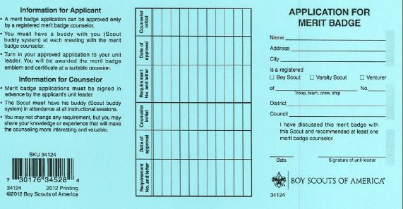
Application for Merit Badge
The Blue Card
Scout’s information
Record of completed requirements
Guide to Advancement 7.0.0.2
Notes:
At some point in the next few years, as the BSA computer systems are upgraded, it is possible the blue card will be replaced—at least in part—by an electronic process. In the meantime, the blue card is the nationally recognized merit badge record. When it is not used it can create problems as Scouts transfer to different units or to different councils, or if in the future the need arises to produce acceptable documentation of merit badges earned.
The Scout’s information, of course, should be completely filled in. [Refer to the screen]
The space provided in the middle portion is for listing requirements completed with date of completion and counselor’s initials. This information is most important when one counselor is not going to be able to approve all the requirements for a particular badge. This often happens in camp settings where another counselor “back home” will approve requirements that could not be fulfilled at camp. Again, the blue card in this case is called a “partial.”
Partials have no expiration except the Scout's 18th birthday.
15

Slide 16
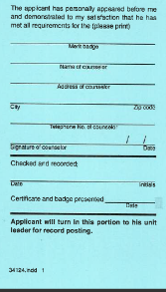
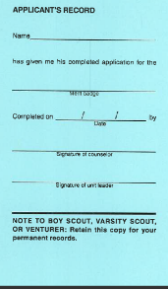
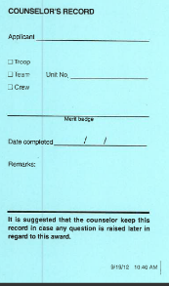
Application for Merit Badge
The Blue Card – Reverse Side
Counselor’s information
Counselor signs in two places once all requirements are complete
Unit leader’s second signature
1/3 goes to the Unit as application for the badge
1/3 goes to Scout for his or her records
1/3 goes to the Counselor’s records
Guide to Advancement 7.0.0.2
Notes:
The reverse side of the blue card is used to record merit badge completions and is divided into three parts:
Left section: unit leader’s portion showing counselor’s personal information, signature, and date merit badge was completed
Middle section: Scout’s portion listing when the merit badge was completed and his or her counselor’s and unit leader’s signatures
Right section: counselor’s portion showing Scout’s name, unit number, and date merit badge was completed
The counselor should retain his or her portion for at least one year in case a question is raised later. The Scout should treat his or her portion as a keepsake, and hold on to it as proof he or she earned the badge. The unit leader’s portion should remain with the unit.
16

Slide 17
Recruiting Merit Badge Counselors
Interface with your District Advancement Chair, or District Merit Badge Coordinator for help.
Ensure the Merit Badge Counselor is Qualified.
Ensure the Merit Badge Counselor recruited understands what he or she should expect at your Merit Badge Day.
Recruit assistants to help the Merit Badge Counselors with their classes.
Notes:
As a counselor you have several duties that hopefully will lead to approving a merit badge.
After reviewing the signed blue card, and with a buddy present, begin a discussion with the Scout to determine:
If he or she has completed work on the merit badge before receiving his or her blue card.
If he or she is prepared to start or continue work on the merit badge.
How much knowledge he or she already has in the subject.
His or her level of interest in the subject.
Then keep an eye on him or her as he or she progresses. In doing this you’ll be playing the roles of both coach and mentor.

Slide 18
Preparing for a Merit Badge Day
All available on Council Website
Application and Instructions
Submit to District Advancement Chair at least 90 Days in advance.
Prerequisites
Not just a minimum. Adding more may preclude the ability to conduct the badge at a group session.
Certain MB’s must be conducted as full day (both sessions).
Merit Badge Day Flyers
Specific items must be included.
Promotion
Council will post to OCBSA Website once approved.
Notes:
As a counselor you have several duties that hopefully will lead to approving a merit badge.
After reviewing the signed blue card, and with a buddy present, begin a discussion with the Scout to determine:
If he or she has completed work on the merit badge before receiving his or her blue card.
If he or she is prepared to start or continue work on the merit badge.
How much knowledge he or she already has in the subject.
His or her level of interest in the subject.
Then keep an eye on him or her as he or she progresses. In doing this you’ll be playing the roles of both coach and mentor.

Slide 19
Merit Badge Day Policy Specifics
Merit Badges recommended for Merit Badge Day are listed on the OCC website with their listed prerequisites.
Recommended For Merit Badge Days,
Not Recommended for Merit Badge Days,
Recommended for Summer Camp
Any Merit Badges that are not on the recommended list that wish to be done for a Merit Badge Day must be approved by the Council Advancement Committee prior to being offered at a Merit Badge Day.
Guide to Advancement 7.0.4.11
Notes:
As a “coach,” the merit badge counselor...
Gauges a Scout’s readiness level and thinks about what will be needed to help him or her complete the badge. An observant counselor may need to spend more time working on skills with younger Scouts and allow them time to practice skills with their buddies. Comments like “You’re doing a good job!” give Scouts the confidence they need to complete the required work.
Encourages Scouts to set goals and monitors their progress, providing friendly reminders with the understanding that the ultimate responsibility to get things done rests with the Scout.
Helps the Scout evaluate his or her progress and encourages him or her to ask for the help he or she needs.

Slide 20
Merit Badge Day Policy Specifics (continued)
All Merit Badge Days will have the same schedule,
3 Hour morning classes,
1 hour lunch and,
3 Hour afternoon classes.
Minimum Counselor to Scout ratio
One registered Merit Badge Counselor per 8 Scouts.
Helpers in a Merit Badge class does not dilute the 8 to 1 ratio of Counselor to students.
YPT procedures will be used in Merit Badge Classes (never alone with Scouts, Two Deep Leadership, etc.)
Maximum Merit Badges for a Scout to earn during a Merit Badge Day is 2 Merit Badges. 1 Eagle Required Merit Badge.
Notes:
Merit badge counselors don’t always have the chance to serve as mentors. Doing so requires a relationship that’s not likely achievable at a merit badge college or midway, for example, unless a Scout and his or her buddy schedule follow-up sessions and work together with you over a period of time. Mentors take more than a passing interest in a Scout’s projects and they share experiences that spark curiosity.
The Scout whom you mentor may get more serious about the subject matter and may want to gain a deeper understanding. This is fine as long as you understand nothing can be added to the requirements.
As one gains experience counseling youth, one gets a sense of these certain young men who take a real interest in a subject. If time permits, it’s appropriate to share specific skills needed to be successful in the counselor’s line of work. Career-minded Scouts working on the Law merit badge, for example, may appreciate knowing which courses to take in preparation for law school.
Helping Scouts set longer-term goals to accomplish not only the required work, but additional studies as desired, is a big part of mentoring. Goal setting, of course, helps them prioritize the merit badge tasks that call for more preparation and planning, but more importantly, the ability to set and attain challenging objectives could change his or her life.

Slide 21
Merit Badge Day Policy Specifics (continued)
Merit Badge Worksheets
May not be a requirement.
May be used as an aide in helping a Merit Badge Counselor but cannot replace proof of completing a requirement or of requirements that have the Scout “show”, “demonstrate”, or “discuss”.
No expectation of completion
Partial completions are a reasonable expectation for attending a Merit Badge Day. There should be no expectations given that if the Scout registers for a Merit Badge completion is assured.
Guide to Advancement 7.0.4.8
Guide to Advancement 7.0.3.3
Notes:
Merit badge counselors don’t always have the chance to serve as mentors. Doing so requires a relationship that’s not likely achievable at a merit badge college or midway, for example, unless a Scout and his or her buddy schedule follow-up sessions and work together with you over a period of time. Mentors take more than a passing interest in a Scout’s projects and they share experiences that spark curiosity.
The Scout whom you mentor may get more serious about the subject matter and may want to gain a deeper understanding. This is fine as long as you understand nothing can be added to the requirements.
As one gains experience counseling youth, one gets a sense of these certain young men who take a real interest in a subject. If time permits, it’s appropriate to share specific skills needed to be successful in the counselor’s line of work. Career-minded Scouts working on the Law merit badge, for example, may appreciate knowing which courses to take in preparation for law school.
Helping Scouts set longer-term goals to accomplish not only the required work, but additional studies as desired, is a big part of mentoring. Goal setting, of course, helps them prioritize the merit badge tasks that call for more preparation and planning, but more importantly, the ability to set and attain challenging objectives could change his or her life.

Slide 22
Merit Badge Day Policy Specifics (continued)
Merit Badge day fees will not exceed $20.00 per Scout per Merit Badge Day, and $5.00 for Lunch.
Any reasonable materials fee for a specific Merit Badge class may be charged in addition to the $20.00 fee IF THE EXTRA FEES ARE NECESSARY.
Only one Merit Badge Day per Unit per Year will be approved.
Merit Badge Days may not be conducted on Council property.
Guide to Advancement 7.0.4.10
Notes:
Merit badge counselors don’t always have the chance to serve as mentors. Doing so requires a relationship that’s not likely achievable at a merit badge college or midway, for example, unless a Scout and his or her buddy schedule follow-up sessions and work together with you over a period of time. Mentors take more than a passing interest in a Scout’s projects and they share experiences that spark curiosity.
The Scout whom you mentor may get more serious about the subject matter and may want to gain a deeper understanding. This is fine as long as you understand nothing can be added to the requirements.
As one gains experience counseling youth, one gets a sense of these certain young men who take a real interest in a subject. If time permits, it’s appropriate to share specific skills needed to be successful in the counselor’s line of work. Career-minded Scouts working on the Law merit badge, for example, may appreciate knowing which courses to take in preparation for law school.
Helping Scouts set longer-term goals to accomplish not only the required work, but additional studies as desired, is a big part of mentoring. Goal setting, of course, helps them prioritize the merit badge tasks that call for more preparation and planning, but more importantly, the ability to set and attain challenging objectives could change his or her life.

Slide 23
Merit Badge Day Policy Specifics (continued)
Certificates of Insurance (if needed) need to be requested of Council two weeks in advance of a Merit Badge Day. Email address: COI@ocbsa.org
Scholarships for Scouts in need will be the responsibility of the Merit Badge Day host Unit.
Notes:
Merit badge counselors don’t always have the chance to serve as mentors. Doing so requires a relationship that’s not likely achievable at a merit badge college or midway, for example, unless a Scout and his or her buddy schedule follow-up sessions and work together with you over a period of time. Mentors take more than a passing interest in a Scout’s projects and they share experiences that spark curiosity.
The Scout whom you mentor may get more serious about the subject matter and may want to gain a deeper understanding. This is fine as long as you understand nothing can be added to the requirements.
As one gains experience counseling youth, one gets a sense of these certain young men and women who take a real interest in a subject. If time permits, it’s appropriate to share specific skills needed to be successful in the counselor’s line of work. Career-minded Scouts working on the Law merit badge, for example, may appreciate knowing which courses to take in preparation for law school.
Helping Scouts set longer-term goals to accomplish not only the required work, but additional studies as desired, is a big part of mentoring. Goal setting, of course, helps them prioritize the merit badge tasks that call for more preparation and planning, but more importantly, the ability to set and attain challenging objectives could change his or her life.

Slide 24
Merit Badge Day Policy Specifics (continued)
All Merit Badge Day Registrations will be done by the Host Unit.
Walkups not allowed.
Switching Scouts IS allowed.
All monies for Merit Badge Days will be collected by the Host Unit.
NO REFUNDS.
Notes:
Merit badge counselors don’t always have the chance to serve as mentors. Doing so requires a relationship that’s not likely achievable at a merit badge college or midway, for example, unless a Scout and his or her buddy schedule follow-up sessions and work together with you over a period of time. Mentors take more than a passing interest in a Scout’s projects and they share experiences that spark curiosity.
The Scout whom you mentor may get more serious about the subject matter and may want to gain a deeper understanding. This is fine as long as you understand nothing can be added to the requirements.
As one gains experience counseling youth, one gets a sense of these certain young men who take a real interest in a subject. If time permits, it’s appropriate to share specific skills needed to be successful in the counselor’s line of work. Career-minded Scouts working on the Law merit badge, for example, may appreciate knowing which courses to take in preparation for law school.
Helping Scouts set longer-term goals to accomplish not only the required work, but additional studies as desired, is a big part of mentoring. Goal setting, of course, helps them prioritize the merit badge tasks that call for more preparation and planning, but more importantly, the ability to set and attain challenging objectives could change his or her life.

Slide 25
Merit Badge Day Feedback
Each Unit Merit Badge Day will have a member of the Council or District Advancement team as an observer.
Each Scout participant and parent will have a survey to complete to give feedback on the Merit Badge Day the Scout has attended.
Each Council or District observer will also provide feedback
Feedback will be shared with the host Unit and the Council Advancement Committee to help make a better Merit Badge experience for participants.
Notes:
Individual requirements for merit badges may not be modified or substituted under any circumstances for any Scout.
Youth with disabilities, however, who want to advance beyond First Class may be approved for alternative merit badges to those required for Eagle. This is allowed on the basis of one entire badge for another. To qualify, a Scout (or a Venturer or Sea Scout) must have a permanent physical or mental disability, or a disability expected to last more than two years, or beyond the age of eligibility. A Scout must complete all requirements that he or she can before being considered for alternative requirements.
They must submit the “Application for Alternative Eagle Scout Rank Merit Badges.” The URL is on the screen. The application must be accompanied by documentation from a qualified health-care professional and be approved by the unit leader, unit committee chair, and the district and council advancement committees.
Before applying, however, the youth must earn as many of the Eagle-required merit badges as possible, and any alternatives must present the same challenge and learning level as those they replace.
25

Slide 26
Wrap Up
We want all Scouts to have a quality experience when attending a Unit Merit Badge Day. We know through the work of many volunteers this can be a great experience for the Scout.
We will share all Feedback with host Units and use the information on the Council Advancement Committee to make improvements.
We ask your cooperation to make this a great program for Scouts.
Notes:
In order to offer quality merit badge programs in a group setting, council and district advancement committees should put reasonable checks and balances in place.
First, assure that only merit badge counselors who are known to be registered and approved are allowed to participate, and that they agree to sign off only those requirements each Scout has actually and personally completed. And be sure that any guest experts or guest speakers, or others assisting who are not registered and approved counselors, are just that and do not behave like counselors, signing blue cards, for example.
Second, counselors should agree on a way to verify that prerequisites for certain merit badges have been completed prior to Scouts attending the session. It must not be assumed that prerequisites have been completed without evidence of some sort, that the work has been done.
Third, concerns about summer camp or other group instructional merit badge programs should be reported to your district and council advancement committee. The form “Reporting Merit Badge Counseling Concerns” in the Guide to Advancement appendix may be used for this purpose.
26

Slide 27
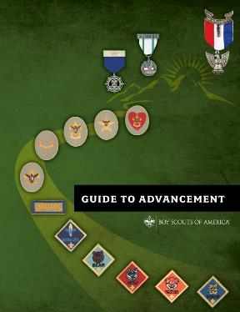
For More Information
Other advancement presentations available at:
www.scouting.org/advancement
Resources
Guide to Advancement, No. 33088
BSA’s Guide to Safe Scouting, No. 34416
Merit Badge pamphlets
Boy Scout Requirements, No. 616334
Application for Merit Badge, No. 34124
A Guide for Merit Badge Counseling, No. 34532
Boy Scout Handbook, No. 34554
Merit Badge Counselor Information, No. 34405
BSA Adult Application, No. 524-501
Merit Badge Group Instruction Guide No. 512-066
Notes:
[Note to the presenter: This is your opportunity to review any details or issues participants indicated earlier that they wanted to be sure were covered. Provide the answers to any that were not covered, and allow further questions from the group as time allows. This is also the time to gather feedback for passing on to the National Advancement Team. Please send any comments or suggestions to advancement.team@scouting.org.]

Slide 28
Questions…
Notes:
Most Scouts will attend summer camp at some point and have the opportunity to earn outdoor-related badges like Swimming, Rifle Shooting, Canoeing, and many of the handicraft-related badges. Merit badge instruction is almost always conducted in group sessions often led by staff members under 18.
Councils must ensure, however, that a registered, qualified, and approved counselor is present to oversee these sessions, and to sign the blue cards verifying that each Scout has actually and personally fulfilled all the requirements as they are written.
There are no camp-related exemptions from the qualifications described under “Qualifications of Counselors,” topic seventy-eleven, in the Guide to Advancement. Councils may not change the rules about who qualifies; this includes eligibility age, as well as registration and approval as counselors.
28

