Slide 1
2024 CAMP CARD SALE
Help us know who is being trained, please right click
and rename your display name to:
First & Last Name – Unit
You may also type your name and unit in the chat.
Download Leader Guide at ocbsa.org/campcard

Slide 2
The Card

Slide 3
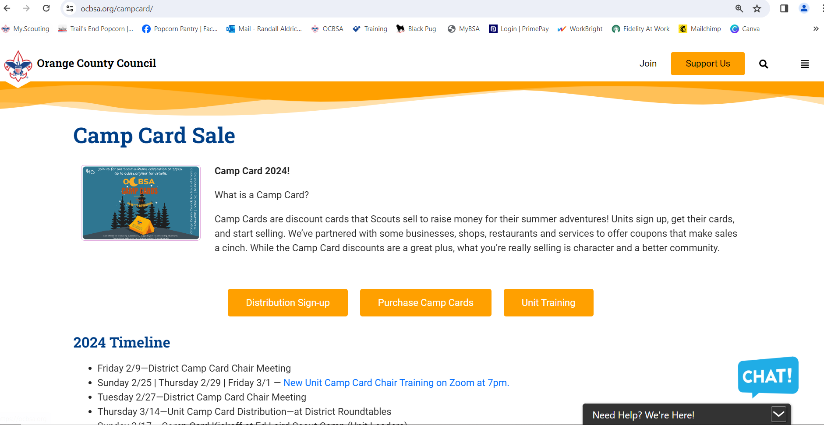
The Website (ocbsa.org/campcard)

Slide 4
District Contacts
Canyons
Michelle Aldrich
Randall Aldrich - DE
El Camino Real
Pam Jensen
Peter Jensen — DE
Golden West
Kathy Hight
Matt Daugherty - DD
Pacifica
Sandra Middleton
Todd Lassig — SDE
Rancho San Joaquin
Alvin Chang
Sarah Whittenberg — DE
Saddleback
Mike Ulibarri
Anthony Geukens - DD
Valencia
Robert Doidge
Travis Bush - SDE
CONTACT INFO ON Page 3 of the Leader Guide
& ocbsa.org/CAMPcard

Slide 5
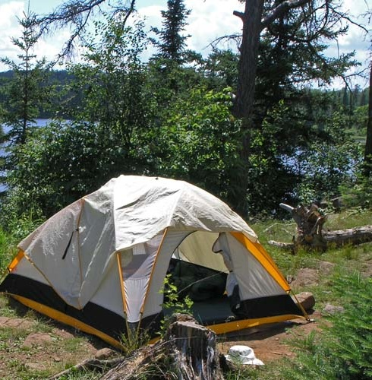
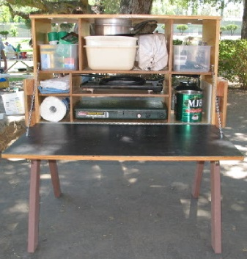
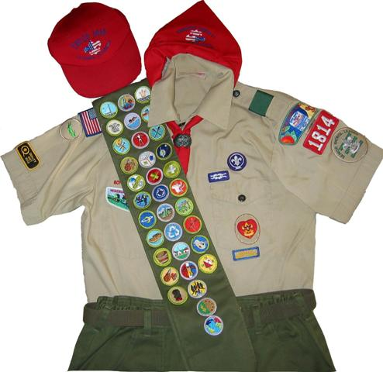
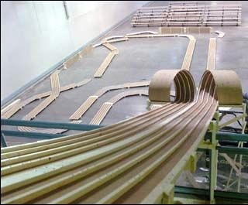
Why sell CAMP cards? RISK-FREE FUNDRAISER – RETURN ANY UNSOLD CARDS
It’s
FUN!
Important Life Skills
Goal Setting
Money Management
People Skills
Customer Service
Sales Skills
CAMP!
Unit Needs
and your Scouts learn life skills
Notes:
Earn money for your unit to go to Day Camp, Summer camp, or even family camp. Help raise money for new unit equipment.
Earn money for unit needs: Uniforms, camping equipment, pinewood derby track, or even upgrade your pot-luck Blue and Gold to a catered meal!
It’s fun for the Scouts and they learn great life skills such as communication, confidence, goal setting, planning, and more!

Slide 6
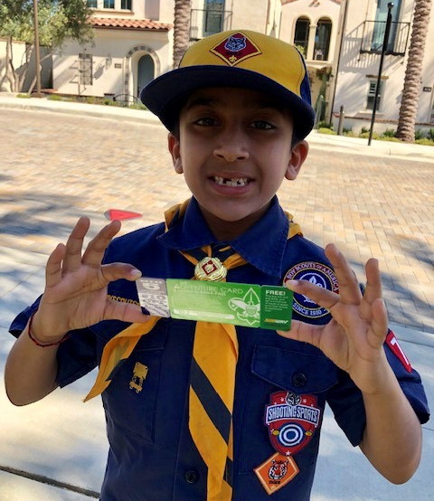
Basic Timeline
Attend Training
Attend Kickoff March 17
Distribution Days
March 14 – Roundtable
March 17 – Kickoff
Storefronts
April 1 – May 9
By May 9 – Account Close Out
May Roundtable
Notes:
Pick your cards up either March 14 or March 17 – you all should have picked your location during registration.
All Cards need to be paid for and any returns need to be turned in by May 22. There will be two scheduled turn in dates/times. The first will be somewhere near the current OCBSA office on May 20th in the evening. The second will be Saturday morning, May 22, in each Service Area.

Slide 7
How to order cards
https://scoutingevent.com/039-CampCardDistribution
Enter your name, email, district.
Then select your unit number.
Enter how many cards you would like.
Let us know If you would like to pick them up at a roundtable or at Kickoff.
Let us know if you would like a 11”x14” poster for Storefronts

Slide 8
Kickoff at Ed Laird Scout Camp
Sunday, March 17
Register at https://www.scoutingevent.com/039-CampCardDistribution
Camp Cards will be distributed at the kickoff
Units will also receive a 11”x14” poster for storefronts if requested
There will be lunch that is served (hamburgers/hotdogs)
There will be training available for those that need it (topics covered will be the same as what is covered today)
**UNITS DOING ONLINE ONLY SALES WILL NOT NEED TO COLLECT ANY CARDS

Slide 9
How to order cards
If you need to order more cards, contact your District Camp Card Chair or District Executive to coordinate unit specific distributions.
Any cards not sold will need to be returned at the end of the sale (May 11).

Slide 10
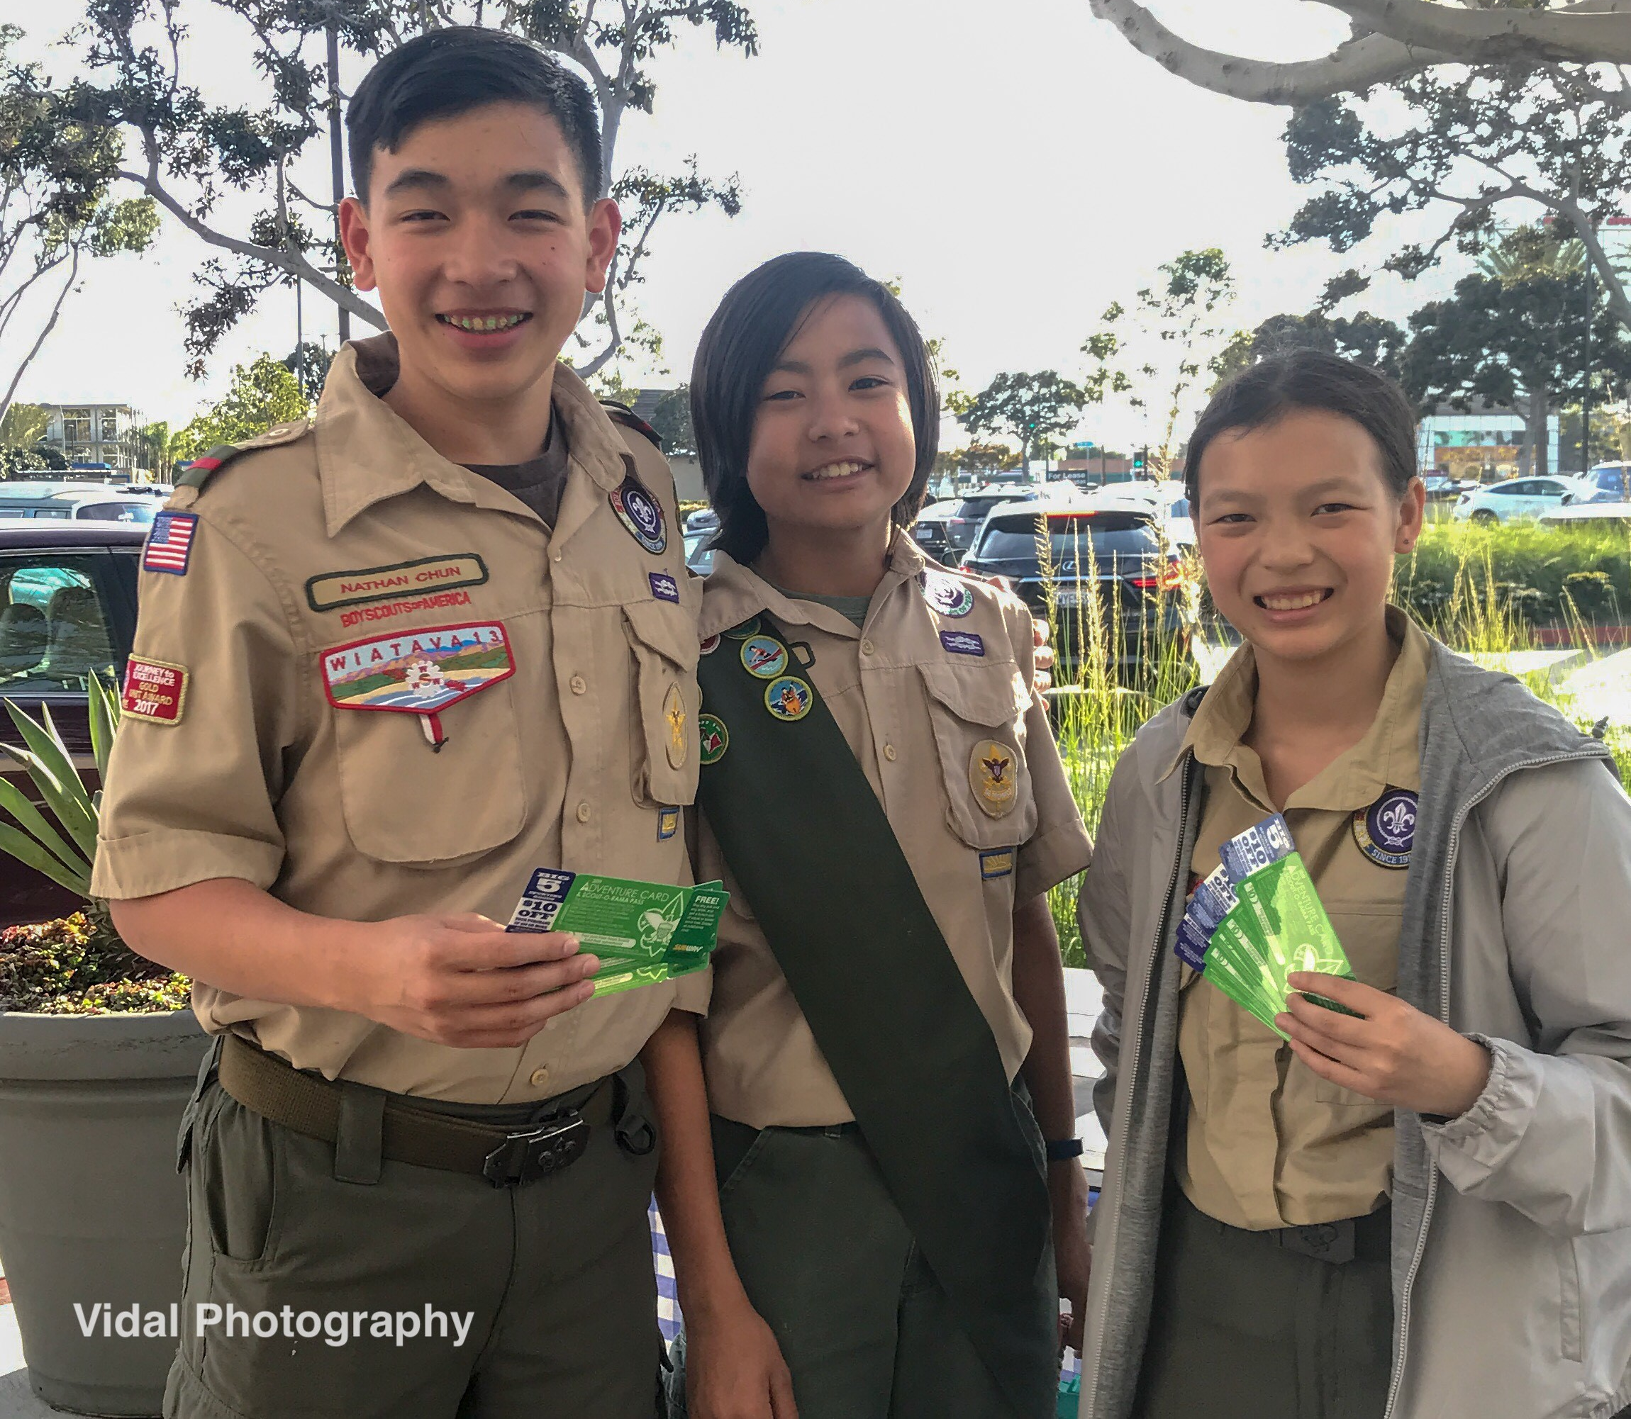
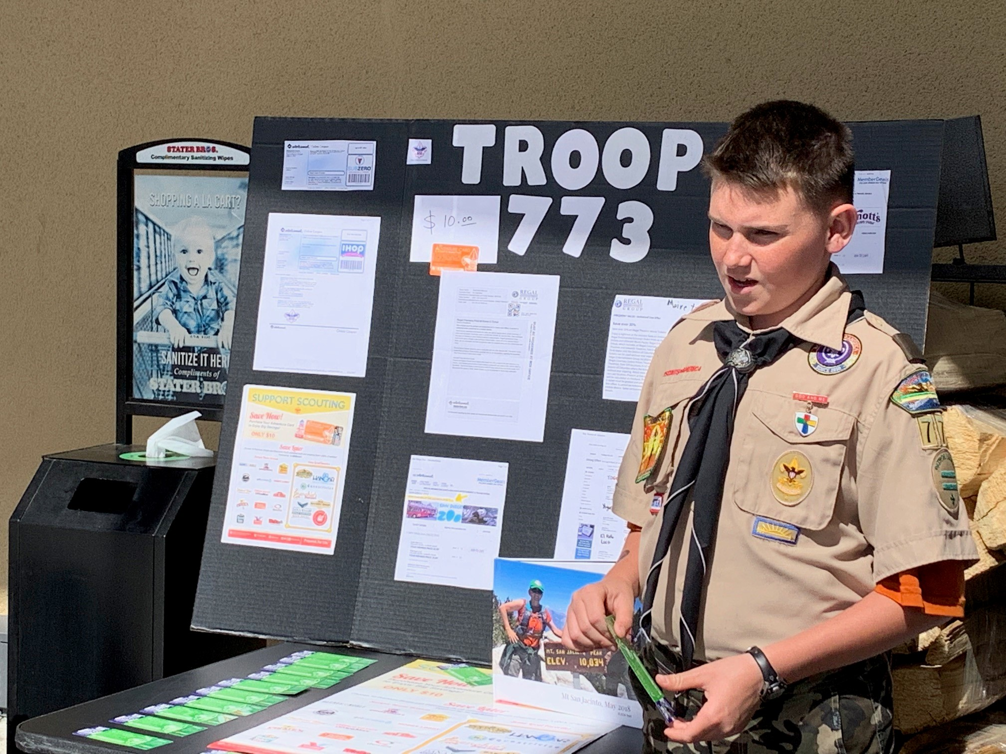
Ways to Sell
Online/Social Media/Email
Friends, Family, Neighbors, Co-Workers, etc.
Door to Door Sales
Store Front Sales

Slide 11
Heroes and Helpers
Someone may purchase a Camp Card that can be donated to a Hero or Helper in the community.*
If your unit has a non-profit that you would like to support, please let us know.
Your unit can coordinate the delivery of those cards with assistance of the council.
The Orange County Council will coordinate the delivery of all other card donations.
In the past we have used schools, OC Food Bank, Joint Forces Training Base at Los Alamitos
The unit will earn $5 commission for every Hero and Helper donation that they get (same as a card sold).
The cards that are donated will count towards that scout’s eligibility in our rewards program.
During the closeout process, the unit will let Council know how many of the returned cards are to be donated.
*Customers online can also purchase a card to be donated to a local Hero or Helper.

Slide 12
Online Sales
Online sales at https://scoutingevent.com/039-CampCards2024
Templates/Graphics will be available at
ocbsa.org/campcard
Cards will be mailed out weekly starting in April.
Your Unit will receive $5 per card sold. After the sale, your Unit Account will be credited with your online commissions.
After the sale, the Council Staff will email you with a list of Scouts and how many cards they sold online.
Notes:
There are graphics and sample copy for social media posts and emails for your Scouts to download and use. Encourage Scouts to create their own videos or share their own photos! Make it personal.
Adv Card sold online will be mailed out weekly.
The reconciliation of sales will be handled after the sale.

Slide 13
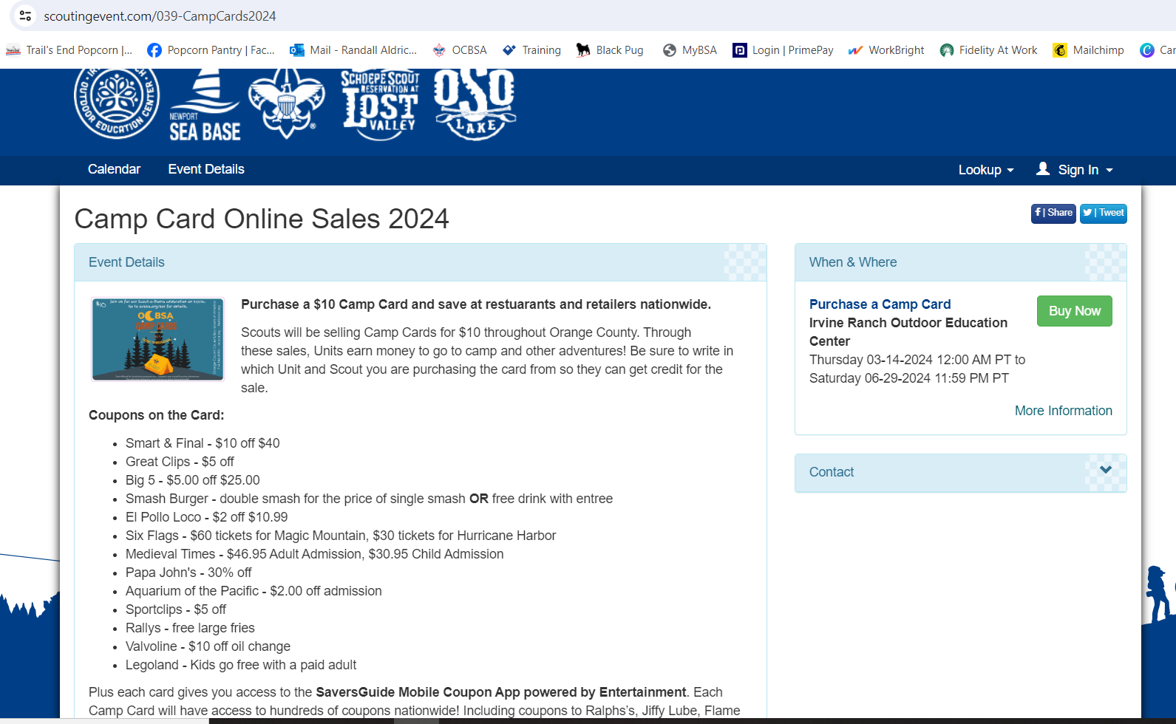
Online Sales

Slide 14
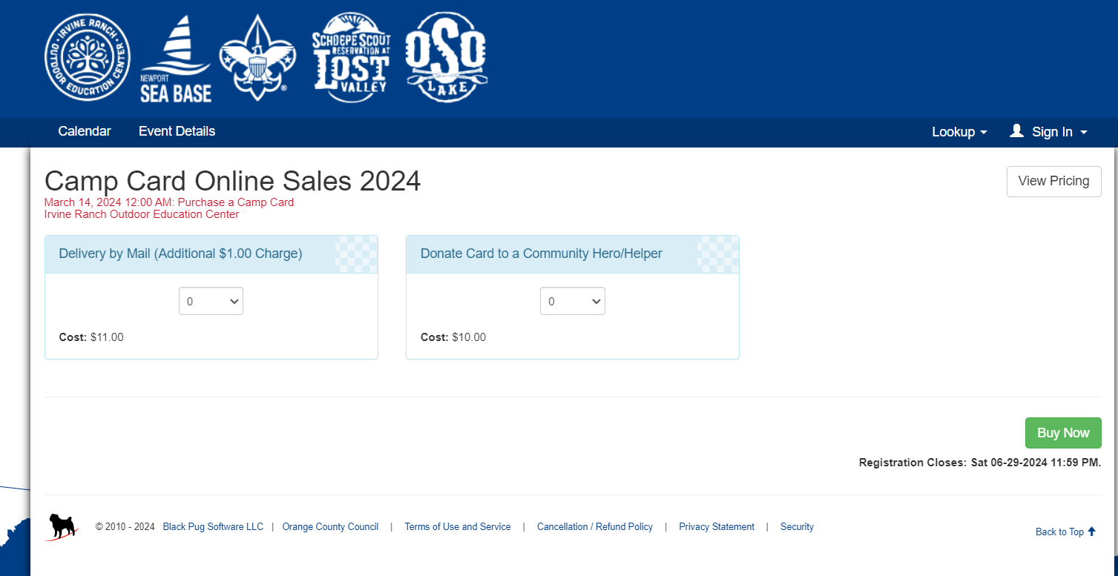
Online Sales
Notes:
The customer will select how many cards or Hero donations they want to purchase.

Slide 15
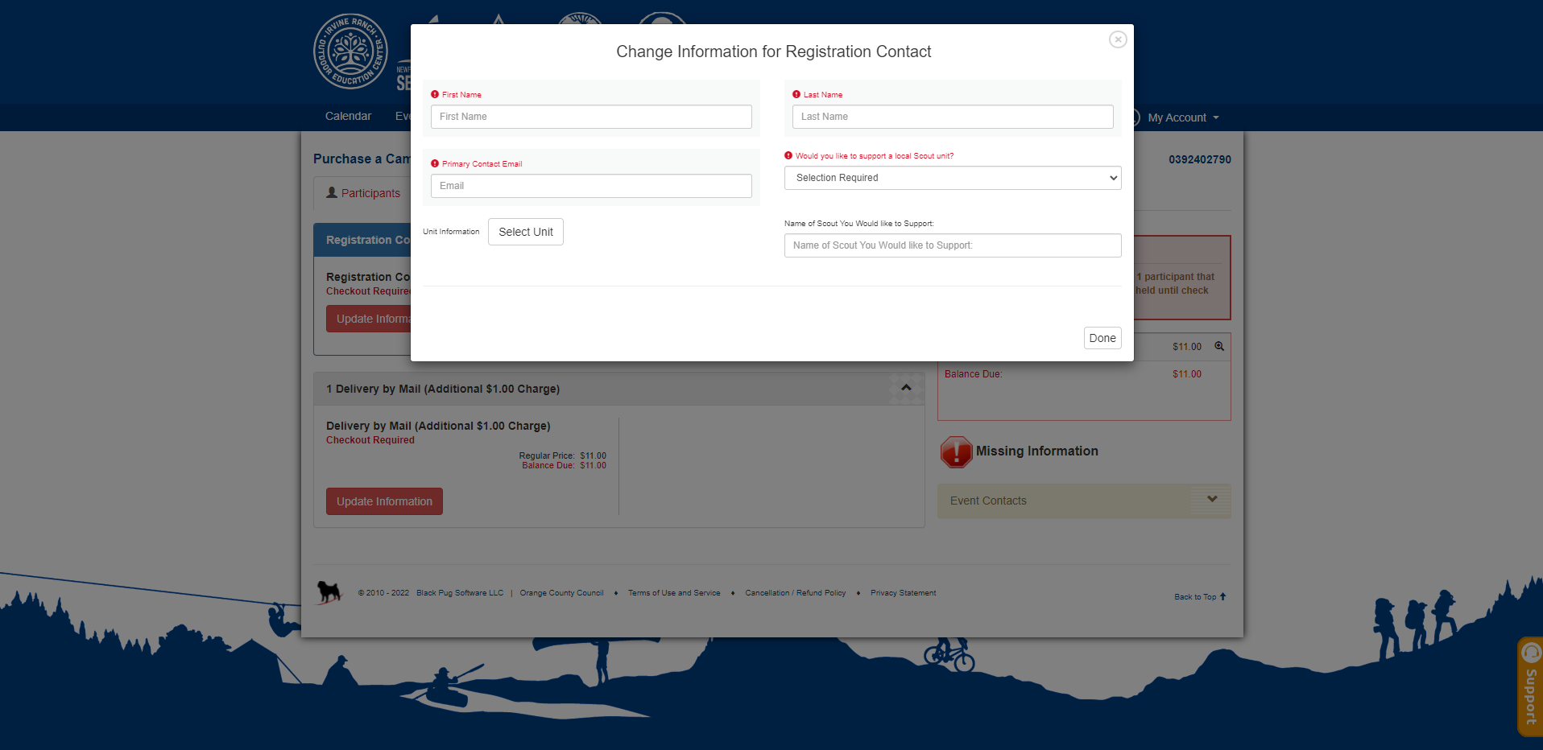
Online sales
Notes:
Customer would add in their name, if they want to support a Unit, the Unit # info, and the Scouts Name.
It’s important that the Scout communicates to the customer to put in the Unit and Scout name info
Then the Customer would add in address at checkout – while putting in credit card info

Slide 16
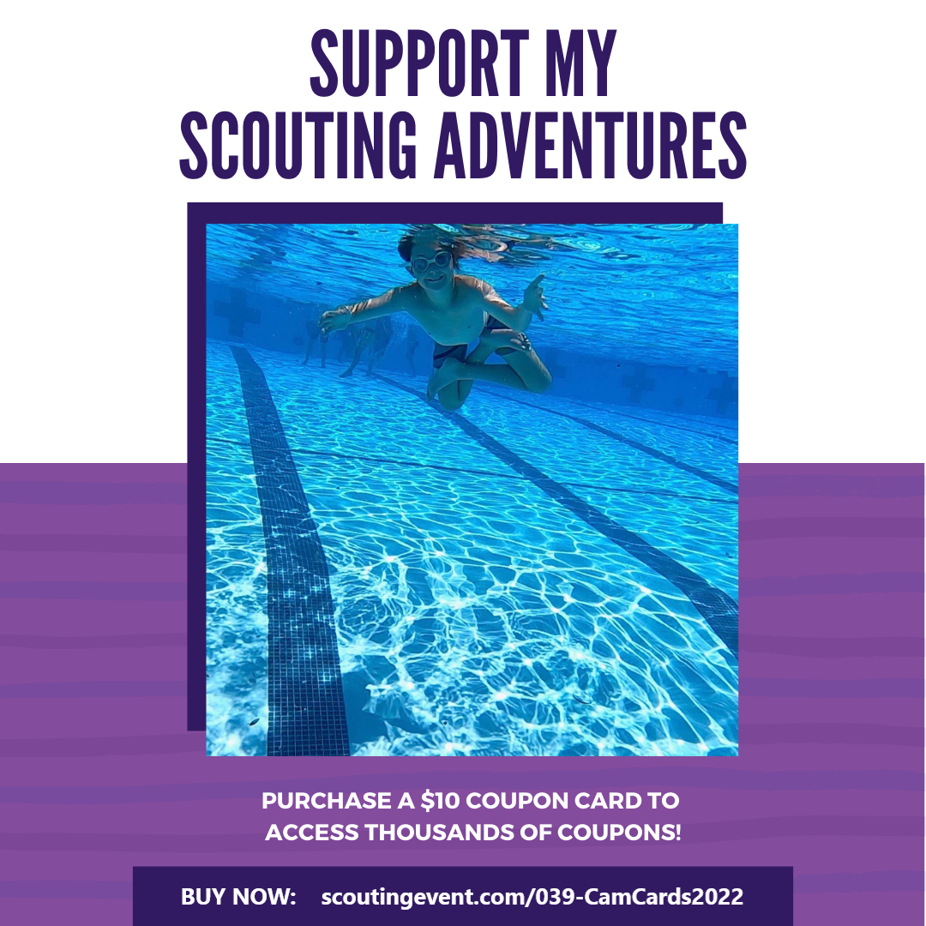
Social media graphics will be available at ocbsa.org/campcard

Slide 17
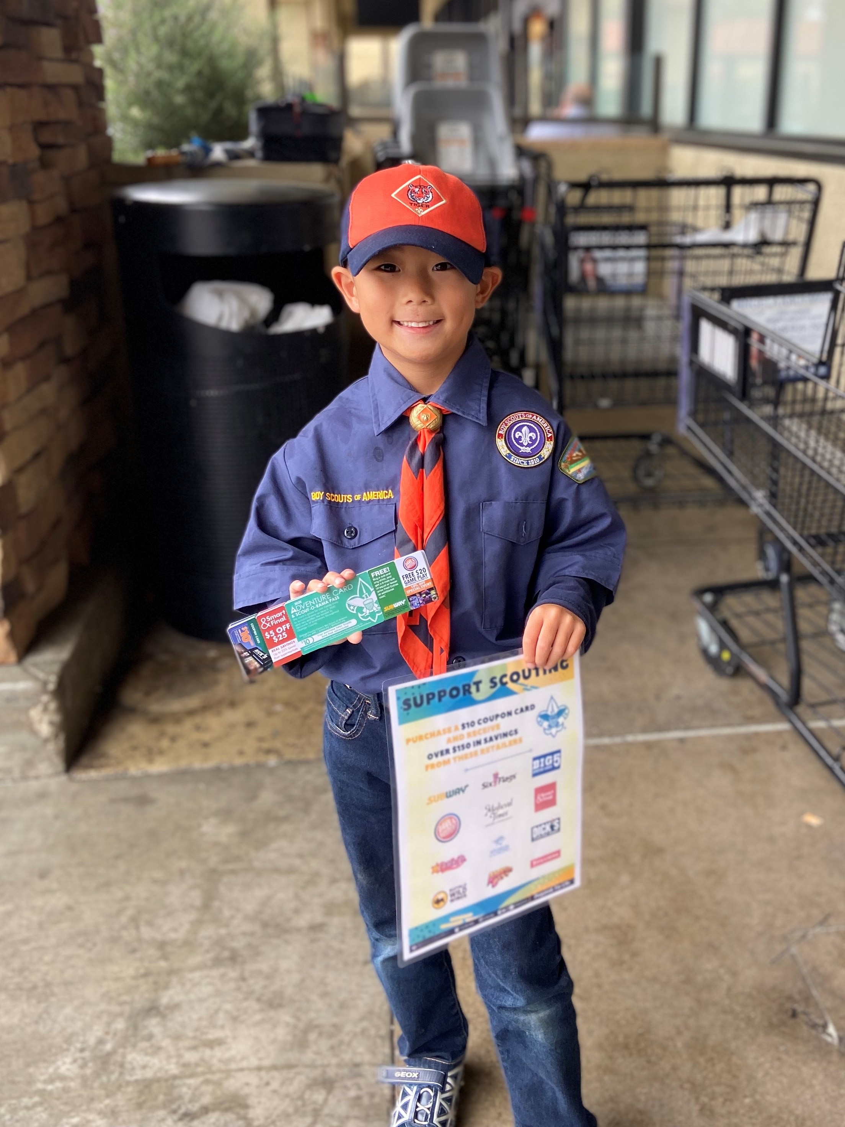
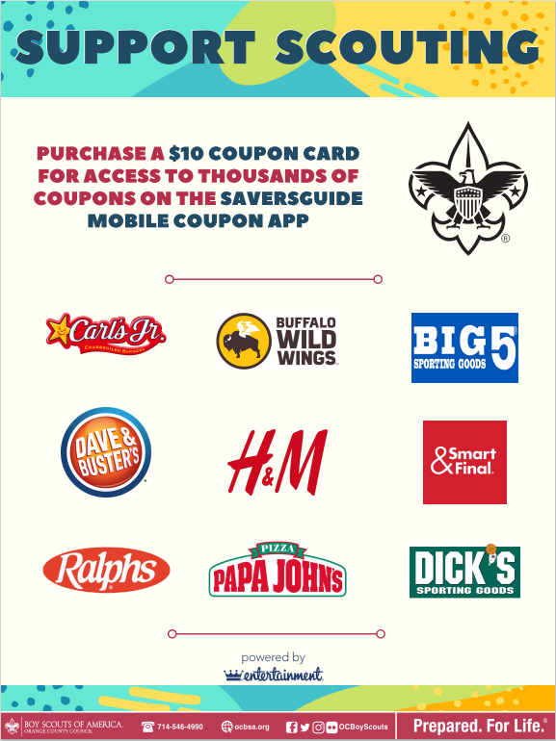
Store Front Sales
Stater Bros. and Irvine Properties
at ocbsa.org/campcard
Starts 4/1/24
Other Locations –
Hardware Stores
Grocery Stores
**Smart and Final**
Think Outside the Box
Posters Will be Available at Distribution
Notes:
Storefront sales is the most popular way to sell the cards.
Reach out to local shops that are featured on the card and see if they will let you sell.

Slide 18
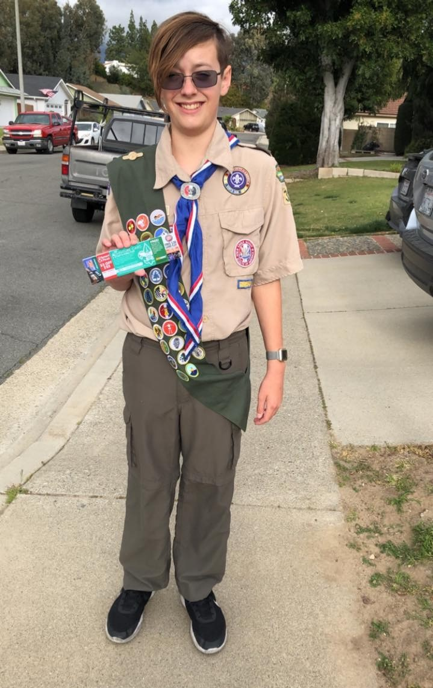
Safety Briefing
After each interaction with a customer, wash hands or use a hand sanitizer with at least 60% alcohol.
Wipe down frequently touched items on a sales table after each shift using regular household cleaning spray or wipes.
Stay home if you are sick or have been around someone sick.
Cover your cough or sneeze with a tissue, then throw the tissue in the trash. Wash hands or use sanitizer.

Slide 19
The Rewards!!
Strive for 25
Scouts receive one entry for every 25 Cards sold. All entries last all season long.
Weekly winners will receive: - $50 campership to an OCBSA summer program. Grand prize winner will receive: - $250 Camperships to an Orange County Council Summer Camp or Day Camp!
Winners will be able to claim their prize once the Unit submits the payment for proof of the 25 Camp Cards sold.
Entries are submitted through your district’s camp card chair or District Executive Forms available at ocbsa.org/campcard
40+ Cards – $10 Amazon Card
150+ Cards – $50 Amazon Card
A scout can earn each reward once.
Order Rewards online by May 13.
Notes:
Strive for 25 –
Scouts receive one entry for every 25 cards sold.
Scouts would let their Unit Adv Card Coordinator know, the Coordinator would complete an online form (link on the website), and submit payment to the Council
All entries last all season long.
Weekly winners will receive
$50 campership toward an OCBSA camp property program
Grand prize winners will receive a $250 campership to a summer camp or day camp
Winners will be able to claim their prize once the unit submits the payment for proof of the 25 cards sold.

Slide 20
The Rewards!!
Scout-o-Rama Front of the Line Pass
• Every Scout that sells a camp card will be entered into a drawing.
• There will be 4 winners that will be selected after the sale is over.
• The winner will win a pass for them and a parent to go to the front of the line at the experiences offered at Scout-o-Rama.
• These experiences may include: Archery, BB Guns, Zip Line and potentially other experiences that are available at the Ed Laird Scout Camp
Notes:
Strive for 25 –
Scouts receive one entry for every 25 cards sold.
Scouts would let their Unit Adv Card Coordinator know, the Coordinator would complete an online form (link on the website), and submit payment to the Council
All entries last all season long.
Weekly winners will receive
$50 campership toward an OCBSA camp property program
Grand prize winners will receive a $250 campership to a summer camp or day camp
Winners will be able to claim their prize once the unit submits the payment for proof of the 25 cards sold.

Slide 21
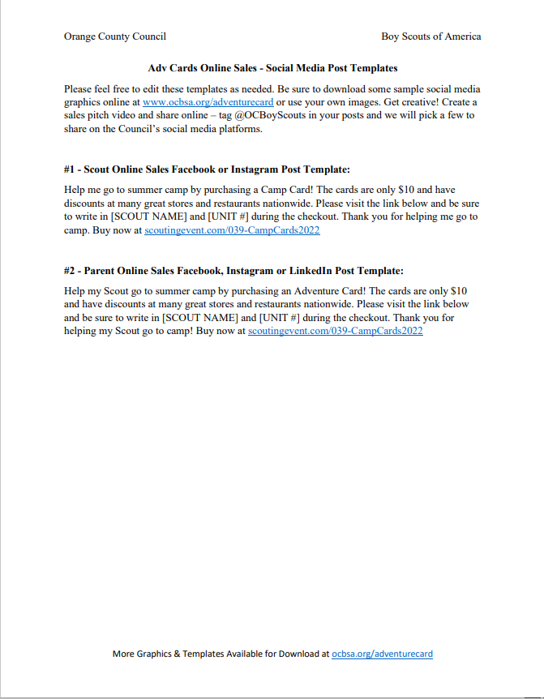
Unit Resources
ocbsa.org/campcard
Leader Guide
Notes:
Leader guide has all this info
Our webpage has all this information and more including a link to sign up for Stater Bro locations
You can download the leader guides, thermometer, poster, action plan, etc.

Slide 22
Unit Resources
Each other!!
Please share if you have experiences on what worked well in your unit last year.

Slide 23
Questions??

Slide 24
THANK YOU & GOOD LUCK
ocbsa.org/campcard

