Slide 1
Eagle - Summit - Quartermaster Project Seminar
Adopted by
The Advancement Committee
Orange County Council
Scouting America
June 2025
Notes:
The Eagle, Summit, and Quartermaster Ranks are all the top rank of each program and considered to be equal

Slide 2
Notice………
This presentation is NOT an official publication of the Scouting America nor the Orange County Council; however the contents are taken directly from the official Scouting America “Guide to Advancement – 2025”.
It is prepared to assist Scouts, Parents, and Scout Leaders.

Slide 3
Purpose of this Workshop
Review the Scouting America Eagle Scout – Venturing Summit-Sea Scout Quartermaster Service Project Requirements
Notes:
While achieving Eagle, Summit, and Quartermaster begins when you join Scouts, we’ll focus this workshop on the respective Service Project Workbooks. We’ll review the requirements for the Service Project and explain the procedures used in the Orange County Council.

Slide 4
Who Sets The Project Requirements?
Set by Scouting America National Committee
Guide to Advancement, 2025, #33088
Eagle Scout Service Project Workbook, #512-927
Sea Scouting Quartermaster Service Project Workbook, #420-011
Venturing Summit Rank Service Project Workbook. #512-938
Orange County Council Advancement Committee implements policies and procedures of Scouting America National and Council.
NO Council, District, Unit or Individual has the authority to ADD to, or SUBTRACT from, any Scouting America advancement requirement.
Notes:
We want you to know that what we present to you today is not simply our understanding of the process. Everything we will be telling you is found in official Scouting America publications. In fact, for most of the presentation, we’ll tell you where to find it.

Slide 5
Eagle Scout Service Project –
Requirement #5
While a Life Scout, plan, develop, and give leadership to others in a service project helpful to any religious institution, any school, or your community.
Guide to Advancement 9.0.2.0, Eagle Scout requirement 5
A project proposal must be approved by the organization benefiting from the effort, your unit leader and unit committee, and the district before you start.
The project must benefit an organization other than Scouting America.
You must use the Eagle Scout Service Project Workbook, Scouting America publication No. 512-927, in meeting this requirement.
Notes:
Now, let’s talk about the Project. The three most important things we want you to remember are that:
1) The project cannot be done for Scouting America. Almost any other organization qualifies, but we’ll give you some details in a few slides.
2) Before you start anything, a project proposal must be approved by the organization benefiting from the effort, your unit leader and unit committee, and your district. And finally,
3) You must use the Appropriate Service Project Workbook, in meeting this requirement.

Slide 6
Quartermaster Service Project Requirement #2 - Leadership –
While an Able Sea Scout, plan, develop, and demonstrate leadership to others in a service project that is helpful to any religious institution, any school, or your community.
Quartermaster Application Requirement 2
A project proposal must be approved by the organization benefiting from the effort, and the Council Representative for the Older Youth Programs, Elizabeth Morgan, before you start.
The project must benefit an organization other than Scouting America.
You must use the Sea Scout Service Project Workbook, Scouting America publication No. 420-011, in meeting this requirement.
Notes:
Now, let’s talk about the Project. The three most important things we want you to remember are that:
1) The project cannot be done for Scouting America. Almost any other organization qualifies, but we’ll give you some details in a few slides.
2) Before you start anything, a project proposal must be approved by the organization benefiting from the effort, and the Council Representative for the Older Youth Programs, Elizabeth Morgan. And finally,
3) You must use the appropriate Service Project Workbook, in meeting this requirement.

Slide 7
Venturing Summit Rank Service Project - Requirement #8
Since earning the Pathfinder Rank, plan and conduct a service project as described in the Venturing Summit Rank Service Project Workbook.
Venturing Summit Rank Application, requirement 8
A project proposal must be approved by the organization benefiting from the effort, and the Council Representative for the Older Youth Programs, Elizabeth Morgan before you start.
The project must benefit an organization other than Scouting America.
You must use the Venturing Summit Rank Service Project Workbook, Scouting America publication No. 512-938, in meeting this requirement.
Notes:
Now, let’s talk about the Project. The three most important things we want you to remember are that:
1) The project cannot be done for Scouting America. Almost any other organization qualifies, but we’ll give you some details in a few slides.
2) Before you start anything, a project proposal must be approved by the organization benefiting from the effort, and the Council Representative for the Older Youth Programs, Elizabeth Morgan. And finally,
3) You must use the Appropriate Service Project Workbook, in meeting this requirement.

Slide 8
Requirements of Service Projects
A few simple steps.
How do I pick a project?
What rules do I need to follow?
How do I know I’ve done everything correctly?
Fundraising
Notes:
We’ll go through this following these few steps.

Slide 9
Picking a Project
Please take a moment to think about these questions. You may choose to write them on a separate sheet of paper.
What are your current interests outside of Scouting?
What are your best skills?
Outside of Scouting, what schools, churches and community groups have influenced your life?
What needs to be done for these groups?
Who would you contact to find how you can help?
How can you use your best skills to help?
Congratulations!
You’ve just chosen a project and identified the beneficiary!
Notes:
Picking a project is probably the step that most Scouts struggle with the longest. But it doesn’t need to be that hard. Take out a piece of paper or write on the back of your presentation materials. [CLICK] Congratulations!
You’ve just chosen a project and identified the beneficiary!

Slide 10
What rules do I need to follow?
Contact your District Advancement staff and be assigned a District Representative for Eagle. For Quartermaster and Summit contact the Council Representative for the Older Youth Programs, Elizabeth Morgan.
It’s recommended that you also use a Project Coach to help you plan and execute your project. (9.0.2.9) After your project proposal has been approved, your Coach can:
Meet with a Scout before work begins, ask the Scout to describe how to plan the project, and offer advice accordingly.
Act as a consultant to point out health and safety issues, advise in the planning process, discuss the plan strengths, weaknesses, and risks; and suggest critical improvements.
Discuss the project report with the Scout and offer advice on how to make a strong presentation at their board of review.
Work cannot begin until you earn the rank of Life, Able Sea Scout, Pathfinder.
“While a Life Scout /Able Sea Scout / after earning Pathfinder…”
Guide to Advancement 9.0.2.2
Notes:
There are obviously some rules that you must follow:
Most importantly, you cannot begin until you earn the appropriate rank.
When you earn Life, Able Sea Scout or Pathfinder Rank:
1)Contact your Unit Advancement Chair or (Eagle /Quartermaster/Summit Coordinator) and get an appropriate Rank Packet. It will contain a lot of this material and help you get started.
2) Contact your District Advancement staff and be assigned a District Representative for Eagle to help you with the process. For Quartermaster and Summit contact the Council Representative for the Older Youth Programs, Elizabeth Morgan.
3) We strongly recommend you use an appropriate Project Coach to help you plan and execute your project. Your Coach may be from your unit or not but should be a subject matter expert on the processes and standards of the service project. No one expects you to be an expert in all the things you will need to do to perform your project. But Leadership is identifying and using all the necessary resources to help you be successful.

Slide 11
What rules do I need to follow?
All Summit/Quartermaster/Eagle Projects are Unit events and need to follow all Safe Scouting guidelines, including Two Deep Leadership
“While a Life Scout /Able Sea Scout / after earning Pathfinder…”
Guide to Advancement 9.0.2.2
Notes:
Two registered adult leaders 21 years of age or over are required at all Scouting activities, including meetings. There must be a registered female adult leader 21 years of age or over in every unit serving females. A registered female adult leader 21 years of age or over must be present for any activity involving female youth. Notwithstanding the minimum leader requirements, age- and program-appropriate supervision must always be provided.

Slide 12
What rules do I need to follow?
Planning and developing are part of the project. Even before you start work! Keep track of the time you spend on this.
“Plan, Develop…”
Guide to Advancement 9.0.2.3
Develop a proposal that meets these 5 requirements (9.0.2.7):
Your project provides sufficient opportunity to meet the requirements.
Your project appears to be feasible.
You have considered safety issues and have addressed them.
You’ve thought through and indicated any action steps to help with further detailed planning.
You are on the right track with a reasonable chance for a positive experience
Your proposal, as documented in the Service Project Workbook, must be approved (By signing the proposal in the Eagle Project Workbook (Slide 17))IN WRITING by the Beneficiary, your Unit Leader, Unit Committee and District Representative before you begin. (9.0.2.7.)
Notes:
Everything you do for your project IS PART OF THE PROJECT. Keep track of who you talk with, the time you spend actively thinking about the project, any research or discussions with your leaders, parents or other Scouts and, of course, the time actually performing the project. All that time is captured as time spent on your project and will be recorded in your project workbook.
But even before you have a defined project, you must develop a proposal and have it approved IN WRITING, before you begin doing actual work. The approvals are from your Beneficiary, your Unit Leader, Unit Committee and District Representative. Your District Representative is the last one to approve and he or she will be looking to know whether you meet 5 requirements.
For Summit and Quartermaster Projects “The District Representative” is the Council Advancement Committee Venturing and Sea Scouting Advancement Advisor

Slide 13
What rules do I need to follow?
“Give Leadership to Others…”
Guide to Advancement 9.0.2.4
There is NO minimum or maximum number of volunteers or hours of work needed to carry out your Service Project (but you need to keep track of all the hours).
You must lead at least 2 other people.
They may be Scouts/Scouters, but it’s not required.
There is no requirement that the project have “lasting value”
Notes:
The Leadership requirement is simple: You must lead 2 other people. While there is no set number of hours necessary, as we discussed in the last slide, hours add up quickly. If you discuss a potential project with your SM for 15 minutes, then discuss it with your proposed beneficiary for another 15 minutes, although that seems like only 30 minutes, it’s at least twice that because there are at least 2 people in each discussion.

Slide 14
What rules do I need to follow?
It may include both ‘for profit’ and ‘non-profit’ groups.
Performed for a business (unless the business is in support of the community),
Of a commercial nature, or
For the benefit of an individual.
“Helpful to any Religious Institution, School, or Your Community.”
Guide to Advancement 9.0.2.5, 9.0.2.6
The Project may not involve Council or National Scouting America properties.
It may NOT be:
Notes:
There are a lot of misconceptions about for whom the project can be conducted. As we said earlier, it cannot be done for the Scouting America or on any Scouting America property.
Other than that, it can be done for a non-profit OR a for profit organization. If it’s for a ‘profit-based’ company, take care that it’s not a commercial based nature. The key test is whether the project primarily benefits the community, as opposed to the profits of the business.
Normally “your community” would not refer to a single individual. However, an approved opportunity may be where an individual in need can affect a community, such as an elderly person able to live at home but unable to maintain their property causing a related dangerous situation. The challenge lies in who will provide approvals. They must come from a source representing the “community,” such as a neighborhood association, watch group, home-owners association, or perhaps a division of a town or county.

Slide 15
What rules do I need to follow?
Routine labor, a job normally rendered, is not normally appropriate for a project. (4.3.2.2-Summit, 9.0.2.11 Eagle)
Can you demonstrate leadership?
Is planning and development required?
What makes an acceptable project?
Must satisfy your beneficiary and adhere to their rules.
This is YOUR project alone.
The Scout must plan the work, organize the personnel needed, and direct the project to completion.
A candidate may not use participation in the project of another candidate to satisfy the Service Project requirement
You may not copy or otherwise share your responsibilities for planning, developing or providing leadership to others
Notes:
The real key to determining an acceptable project is can you demonstrate leadership thorough planning, development and execution?
Remember, this is your time to shine. You may not share your project with another. You alone must satisfy your beneficiary’s needs.

Slide 16
What rules do I need to follow?
Following the Workbook ensures you:
“Use the Service Project Workbook”
Guide to Advancement 9.0.2.8.
Are following the correct process.
Have captured the appropriate approvals.
Have Documented appropriate details.
Provide your Board of Review the information to determine if you have met the requirements.
Notes:
The last rule we want to tell you about is that you must use the Service Project Workbook. MAKE SURE YOU USE THE CURRENT VERSION.
You can obtain the Workbook on-line and even fill it in electronically. Using the workbook almost guarantees your success because it will walk you through all the appropriate steps and approvals.

Slide 17
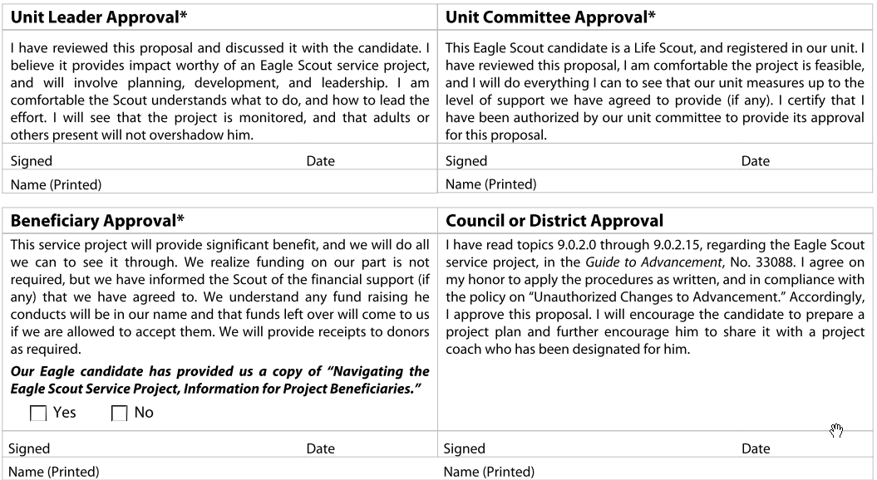
Using the Service Project Workbook
Name, Unit information (Committee Chair, Advancement Coordinator, Beneficiary, Council, District Representative
Section: Contact Information
Section: Project Proposal
Describe project broadly
This is the part that needs 4 Approvals for Eagle and Quartermaster and 3 approvals for Summit
Notes:
When using the workbook, you’ll be asked to identify contact information to help ensure you meet all the necessary steps. The first step in the project is to develop a proposal. Extreme details are not necessary. You just need to describe the project broadly in order to get the 4 approvals necessary for you to begin work. Your District Representative must be the final approval. The insert on this pages and the following are taken from the Eagle Scout Service Project Workbook and are similar but not identical to the Quartermaster and Summit Service Project Workbooks.

Slide 18
Using the Service Project Workbook
Section: Service Project Plan
This section of the workbook is recommended – it is not required
This is your detailed plan (after approval)
Material,
Detail how you will demonstrate Leadership
Time, labor, and schedule,
Safety,
Tools,
Expenses,
Permits,
Logistics,
Contingency plans, etc..
When your detailed plan is complete,
carry out your project!
Notes:
After Proposal approval, you need to develop your detailed plan. This is the heart of your project.
Then [CLICK] Carry out your project.

Slide 19
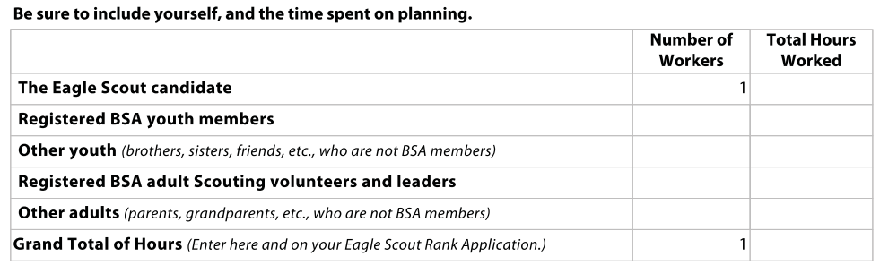
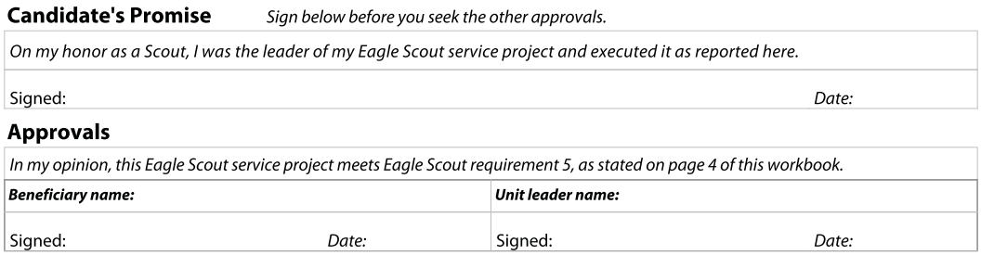
Using the Service Project Workbook
Section: Project Report
Describe the results; What happened?
  Show logs of your efforts.
  Requires your promise and 2 approvals.
Notes:
Although we know this will take time, once you complete your project, you’re not finished yet.
The Service Project Report lets you describe the differences between your Final Plan and what actually happened. You can describe what went well, what was challenging and generally, how you led the project.
You must sign the promise that you completed and were the leader of the project and your beneficiary must sign that they are happy with what you did.

Slide 20
What rules do I need to follow?
Fundraising is not required but can provide evidence of Leadership.
Fundraising
Guide to Advancement section 9.0.2.10.
Fundraising must conform to the Guide to Safe Scouting
Projects may not be Fundraisers
Fund raising is permitted only for the purpose of acquiring the materials and supplies needed to carry out your project.
Notes:
Now, let’s talk about how you fund your project. One common myth is that a Scout must raise funds to carry out a project. That’s not necessarily true, but fundraising does demonstrate evidence of leadership.
When done, Fundraising is only for the purpose of acquiring materials and supplies. Your project may not simply be a fundraiser.

Slide 21
What rules do I need to follow?
Any Service Project Fundraising effort that is expected to raise less than $1000.00 from other than exempt parties (the Scout, the Scout’s parents, relatives, unit members, its chartered organization, parents of unit members, or the beneficiary) does not require a Service Project Fundraising Application. There are no limits on funds raised from exempt parties.
Fundraising
Orange County Council Policy
Service Projects that are expected to raise more than $1000.00 (except from exempt parties) must utilize the appropriate Service Project Fundraising Application. This $1000.00 limit of non-exempt funds applies to the total of cash and gifts in kind.
Notes:
The Guide to Advancement allows Councils to set their own rules on how fundraising can be performed. Orange County Council has adopted some special rules that we show here.

Slide 22
What rules do I need to follow?
Even the best planned activities sometimes need change. You will not necessarily be penalized if you had to vary from your plan.
What if things go wrong with my project?
On the other hand, if your project did not substantially follow your plan . . . then have you truly demonstrated the leadership skills expected of a Quartermaster/Summit/Eagle Scout?
Your project must be completed according to the wishes of your beneficiary. If you need to make substantial changes, you must verify they are acceptable to your beneficiary.
Notes:
Nobody expects you to be perfect. Remember, Do Your Best and Be Prepared are the lynchpins of the Scouting program. Things may go wrong. How you handle them is a testament to your leadership.

Slide 23
Special Topics
What if you are having problems?
Get HELP: (Quickly, do not wait for it to get better on its own)
Talk to your Scoutmaster, Ship Skipper, or Venture Crew Advisor.
All Scouts have the right to ask for a board of review at any time. If you are having a problem within your unit:
Talk to your Unit or District Coach
Talk to your Unit Committee Chairperson.
Talk to your District Advancement Chairperson.
If you think you are not being treated fairly or that you are being held to extraordinary standards, contact the District Advancement Chairperson or the District Chairperson.
Do not delay, the more promptly problems can be resolved the better.
Talk to your Unit Advancement Chairperson.
Notes:
Finally, your leaders are there to help you. If you are having difficulty, talk to them as soon as possible. If you think you are not being treated fairly or that you are being held to extraordinary standards, contact the District Advancement Chairperson or the District Chairperson.

Slide 24
Special Topics
If you are almost 18 – or 21 for Quartermaster and Summit…
Work hard to complete your requirements.
Know your deadlines in advance.
Talk to your leaders now so that they can help you and warn you of problems.
Remember that adult leaders have busy lives. Be respectful of others’ schedules.
Notes:
Remember, keep working, keep talking and remember your deadlines.

Slide 25
Special Topics
Myths
The Scout can not receive help from their parents
The project must involve wood construction
Can not involve any volunteers from outside the unit
Must include multi-media presentations
The project must be completed within 30 days
The project must be completed as the last requirement
The project write-up must be done in such a way that any other Scout could complete it
The Scout must be 16 years of age before beginning work
The project must have a minimum of 200 hours
The project must have “lasting value”
Notes:
At this time, we’d like to dispel some common myths about the Eagle/Quartermaster/Summit rank and project.

Slide 26
Q & A and OCC Website
Any Questions?
OCC Website
www.ocbsa.org
Thanks!
www.ocbsa.org/advancement/
Notes:
This concludes todays workshop.
We’ll be happy to take any questions and also to point you to the Orange County Council Advancement Website.
Thanks.

